Slide 1

The Artistic Performance
"Operation of the Information Technology Services Administration and the renewal of licenses for the King Abdul Project." The translation of "العزيز" is "the dear" or "the beloved." It is often used as a term of endearment or for someone who is cherished. The exact translation can depend on the context in which it is used. If you provide more context or the complete phrase, I can give you a more specific translation.
For public transport
Presented to
The Royal Commission for the City of Riyadh

Slide 2
We extend our thanks and appreciation.To the Royal Authority of the City of RiyadhThank you for giving us the opportunity to offer our services by inviting us to apply for the project."Operation of Information Technology Services Management and License Renewal at the King Abdulaziz Project" For public transportation"Based on our diverse skills and expertise in this field, we are honored to present this proposal as the Digital Future Company to ensure the delivery of the best experiences."
In our technical and financial presentation, we have taken into account the specifications and special conditions outlined in the project’s terms and conditions document and its appendices. We hope that this proposal aligns with your expectations and meets your satisfaction.
Gratitude and Appreciation

Slide 3

Covering the requirements of the specifications and special conditions.
The part related to our artistic presentation.
Commitment
The Standard
Understanding the scope of the project It seems you've provided the Arabic word "صفحة," which translates to "page" in English. If you have additional text or a specific context in which this word is used, please share that for a more nuanced translation.It seems that you have provided the number "14" without accompanying text for translation. If you have a specific Arabic text that you'd like to translate, please provide it, and I'll be happy to assist you with an accurate English translation.It seems that there is no Arabic text provided for translation in your message. Please provide the text you'd like me to translate, and I'll be happy to assist you!
Understanding the scope of work and project requirements.
Methodology for Project ImplementationPageIt seems that you only provided the number "16". Please provide the full Arabic text you'd like translated, and I will be happy to assist you.It seems that there's no Arabic text provided for translation. Kindly share the text you'd like translated, and I'll be happy to assist you!
Proposed Implementation Methodology
The organizational structure and project team It seems that the text you provided is just a single word: "صفحة," which translates to "page" in English. If you have more text or specific context that you would like translated, please provide that, and I would be happy to assist!It seems that you've provided just the number "44" without additional context or text to translate. If you have a specific Arabic text or passage you'd like translated, please provide it, and I'll be happy to assist you with an accurate and nuanced translation!It appears that there was no Arabic text provided for translation. Please provide the Arabic text you would like me to translate, and I'll be happy to assist you!
Project Team
Our ProjectsSure! Please provide the Arabic text you would like me to translate.It appears you've only provided "صفحة 65," which translates to "Page 65" in English. If there is additional text or content from that page that you'd like to have translated, please provide it, and I'll be happy to assist!It seems like you didn't provide the Arabic text you'd like to have translated. Please share the text, and I'll be glad to help with the translation to English!
Specialized experience in relevant projects

Slide 4


Executive Summary
Project Scope of Work
MethodologyProject Implementation
Project Implementation Timeline
Organizational Structure and Teamwork
Project Assumptions
About Future Digital Company
Our Clients
Our Projects
4

Slide 5
Executive Summary

Slide 6


Company Overview
The Digital Future Communications and Information Technology Company is a classified and specialized company that provides comprehensive services and solutions, including top management consulting services, managed by a team of advisors and specialists in the field.ConsultationsAdministrative and Information Technology departments comprise experts from highly skilled and competent developers who all work towards a unified approach. They are distinguished by their dedication, precision, commitment, trustworthiness, and integrity; all of this serves a single purpose: to meet the needs and requirements of clients.
Vision
Maintaining a leading position in the market."Digital"In everything we do, by providing the latest integrated solutions and expanding the scope of our offerings and services in the market.
The Message
We are working on providing solutions.DigitalCost-effective and high-quality, they enhance our knowledge and familiarity.It seems that you haven't provided the Arabic text for translation. Please share the text you'd like to have translated, and I will be happy to assist you!Our commitment drives us to support our clients and nurture our employees.It appears that the Arabic text you would like translated is missing. Please provide the text, and I'll be happy to help with the translation.

Slide 7
Our Competitive Advantage
We have successfully carried out numerous similar projects.
Various entities and institutions are striving to build strategic partnerships and delegate qualified partners to implement a range of services following the managed services model. We have assisted numerous organizations and bodies in both the private and public sectors by providing our professional managed services for information technology. We will collaborate with the Royal Commission for the City of Riyadh as part of this project to manage the agency's databases and website according to our developed standard methodologies for this purpose.
It seems that the Arabic text you would like me to translate is missing. Please provide the text you want translated, and I will be happy to assist you.
Deep understanding of information technology services
At Digital Future Company, we possess a broad and deep understanding and expertise in information technology services, including how to develop, manage, operate, and enhance them.
It seems that you haven't provided the Arabic text that you want translated. Please share the text, and I will assist you with the translation.
Our Methodologies Globalization
At Digital Future Company, we adopt globally recognized methodologies in managing IT services, developing and operating systems and applications, as well as database management. We employ these methodologies with utmost professionalism in executing our projects, which enables us to achieve the best outcomes with the highest possible quality while adhering to schedules and budgets, managing and mitigating risks, and complying with established service level agreements.
Qualified competencies and skilled personnel
Our team includes specialists who have a proven track record in executing similar projects, and our team also includes...Consultants"Work of professionals and project managers licensed by the Institute.""PMI" can refer to various terms depending on the context, such as "Private Mortgage Insurance," "Project Management Institute," or "Purchasing Managers' Index." If you provide more context or specify which PMI you are referring to, I can assist you further with the translation.It seems there was a mistake as you didn't include the Arabic text you wish to have translated. Please provide the text, and I'll be happy to assist you with the translation! "And my architects.""Reliable institutional solutions certified by (..."TOGAFIt seems that the text you mentioned for translation is not included here. Please provide the Arabic text you would like me to translate, and I will be happy to assist you!It seems that there was an error in your request; no Arabic text was included for translation. Please provide the Arabic text you would like me to translate, and I'll be happy to assist you!"Technical infrastructure operations managers holding a certification"ITIL (Information Technology Infrastructure Library) is already an established term in both Arabic and English. It refers to a set of practices for IT service management (ITSM) that focuses on aligning IT services with the needs of the business. If you need a specific translation or context for a text related to ITIL, please provide that text, and I'll be happy to assist!Translation: "business analysts and systems analysts, and developers."Translation: specialistsQuality, and my consultants.The translation of "ومصمميي" is "and my designers." If you need further context or have more text for translation, feel free to provide it!Improving the user experience and database administrators.The translation of "واخصائيي" is "specialists."Governance, information security, and other supportive specialties for the successful and professional implementation of the project.
It appears that you’ve provided the numeral "3" without any accompanying Arabic text to translate. Please provide the specific Arabic text you would like me to translate into English, and I'll be happy to assist you!
It seems that you only provided the number "4" in Arabic. Could you please provide the complete text that you would like me to translate? That way, I can assist you accurately.

Slide 8










"Selected Projects for the Digital Future"
The second phase of the digital transformation project at the Ministry of Industry.
Operation and maintenance of the spatial gateway, information boards, and spatial indicators.
Providing consulting services and support for managing digital enablers.
Preparation, design, structuring, and governance of data.
The Comprehensive Application of the Office of Technical Project Management
Geospatial Solutions Programs
Development of the internal and external portal for the Eastern Health Cluster.
"Technical Governance, Its Structure, and the Implementation of the Technical Strategy for the Ministry of Interior"
Providing consulting services and technical support services.
Consulting services for the development of water organization operations.
Providing consulting services and technical support to develop a unified vision for the Ministry of Environment, Water, and Agriculture.
Developing criteria for the inclusion of promising and leading national companies.
Development of Services for the Procedures of the Ministry of Interior Agency for Military Affairs - Phase One
Development of electronic services for project management and the provision of technical and strategic support to the ministry.
Details of the projects in the appendices.

Slide 9
Scope of Work
The Royal Commission for Riyadh City is seeking to appoint a consulting entity to undertake the task of identifying the requirements for the management of information technology services and renewing licenses for the King Abdulaziz Public Transport Project in Riyadh, for a period of 4 years, through 4 work packages.*
Package 2: Improvement and IntegrationITIL (Information Technology Infrastructure Library) is a set of practices for IT service management (ITSM) that focuses on aligning IT services with the needs of the business. It provides a framework for the development, delivery, and improvement of IT services. Through an organizationITSM Translation: IT Service Management
Implementation of PrinciplesITIL (Information Technology Infrastructure Library)"Within an Organization"ITSM translates to "Management of Information Technology Services" in English, which refers to the processes and practices used for designing, delivering, managing, and improving the way IT is used within an organization.The text you've provided seems to contain just "لـ," which is a preposition in Arabic often meaning "for" or "to." Since it lacks context or additional words, I cannot provide a broader translation or interpretation. If you have a longer text or additional context that you'd like translated, please share that, and I'd be happy to help!It seems like you've provided "TCC" which appears to be an acronym or specific term that typically does not require translation. However, if you meant to include additional Arabic text for translation, please provide that text and I would be happy to assist you with the translation.Focusing on delivering value, alignment, and continuous improvement. This includes iterative enhancements through change management, service catalog, and incident and problem management.
Package 1: Data Center MaturityThe text you provided, "TCC," doesn't appear to contain Arabic words or phrases to translate. If you meant to include a specific Arabic text for translation, please provide it, and I'll be happy to assist you with an accurate translation!
The translation is: "It includes improving the data center environment through strategic initiatives, including business engineering, business continuity, and information security consulting."
Bundle 4: Licenses and Subscriptions
Aiming to simplify supply processes and standardize annual renewals for a period of 4 years.
Package 3: Maturity of IT Service Management Services inIt seems you've only provided "TCC" without any Arabic text to translate. If you could provide the Arabic text you would like translated, I would be happy to help!
Management of information technology infrastructure, system operations, governance, email, domain services, and information security interface.
Of course! Please provide the Arabic text you would like me to translate into English. During the Q&A session, we were informed that the booklet announced on the Etimad platform is not the final version and that package number 5 related to disaster recovery management has been canceled.

Slide 10

We propose that this project be executed through a methodology consisting of three phases, which will be applied by following proven and successful mechanisms for each phase...
The translation of the Arabic word "التسليم" is "Delivery." However, the word "التسليم" can have different meanings based on context. It could also mean "acceptance" or "submission" in certain contexts. If you provide more context or a sentence where the term is used, I can offer a more precise translation.
Operational Management
Assessment
The outputs and all project documentation will be delivered, and the project closure phase will be executed according to global best practices in project management.
Operations and policies will be implemented according to best practices and global standards, with performance monitoring, issuance of regular reports, and the development of the agency's staff efficiency through workshops and on-the-job training.
The management of Information Technology Services will be evaluated inIt seems like you've provided "TCC" without any surrounding text for translation. "TCC" could refer to a variety of things depending on the context, ranging from an acronym in academic or corporate contexts to specific titles of organizations. Could you please provide the complete Arabic text that you would like me to translate?In terms of policies, processes, and tools used, and providing a comprehensive document with recommendations.

Slide 11
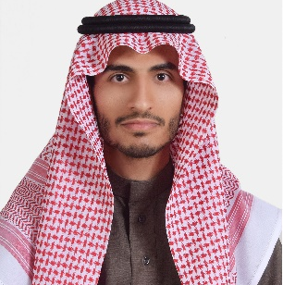

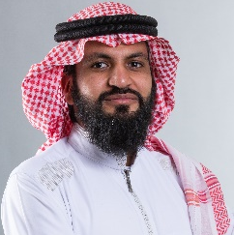
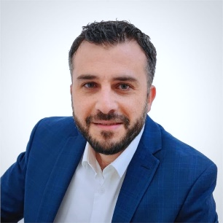
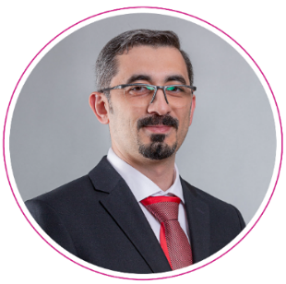
The company comprises a wide range of local and global expertise that will be leveraged to achieve the desired impact of the project.Please provide the Arabic text you would like me to translate, and I will be happy to assist you!
Mohannad Fahd Al-Mishari
Rana Khalil
Mohammad Adnan is an interrogator.
Najib Nasser
Data Analyst
Quality Management Consultant
Business Continuity and Cybersecurity Consultant
Specialist in Institutional Structure
Ramzi Ahmed
Anas Nabulsi
Technical Asset Management Specialist
Translation: SpecialistITIL
Please provide the Arabic text you would like me to translate into English, and I will be happy to assist you.Translation: In addition toIt appears that the text you provided is simply "12." If you meant to provide a longer or different text for translation, please share it, and I will be happy to assist you!Human resources available within the authority as mentioned in the annex.It seems that the text you provided ("KAPT-DI-ITSM-RFP)") does not contain any clear Arabic language content to translate. It appears to be an acronym or a code possibly related to a Request for Proposal (RFP) in the context of IT Service Management (ITSM). If you meant to provide a different Arabic text for translation, please share that text, and I would be happy to assist!It seems like the text provided is just a single word: "بند," which translates to "item" or "clause" in English, depending on the context. If you have additional text or context for this term, please provide it so I can give a more accurate and nuanced translation. It seems that you have provided only the number "7.2" without any accompanying Arabic text to translate. Please provide the Arabic text you would like translated into English, and I'll be happy to assist you!They will be recruited to work within the scope of the project.The translation of "شاملاً" is "comprehensive" or "inclusive," depending on the context.CIO, CTO Translation: Chief Information Officer, Chief Technology Officer

Slide 12
Project Timeline*
The Fourth Year |  |  |  | The Third Year |  |  |  | The second year |  |  |  | The First Year |  |  |  | The year
The Fourth Quarter | The Third Quarter | The second quarter | The first quarter | The Fourth Quarter | The Third Quarter | The second quarter | The first quarter | The Fourth Quarter | The third quarter | The second quarter | The first quarter | The Fourth Quarter | The third quarter | The second quarter | The first quarter | The Stage
 |  |  |  |  |  |  |  |  |  |  |  |  |  |  |  | Assessment
 |  |  |  |  |  |  |  |  |  |  |  |  |  |  |  | Operation
 |  |  |  |  |  |  |  |  |  |  |  |  |  |  |  | Submission
On-the-Job Guidance
The stages, outputs, and associated tasks within the scope of the technical presentation have been detailed.

Slide 13
Executive Summary
Project Scope
MethodologyProject Implementation
Project Implementation Timeline
Organizational Structure and Team Work
Project Assumptions
About Future Digital Company
Our clients
Projects of Ours
13

Slide 14
Scope of Work
The Royal Commission for the City of Riyadh is seeking to appoint a consulting entity to undertake the task of identifying the requirements for managing information technology services and renewing licenses for the King Abdulaziz Public Transport Project in Riyadh, for a duration of four years, through four work packages.
Bundle 2: Improvement and IntegrationITIL (Information Technology Infrastructure Library) "Through the Organization"ITSM stands for "Information Technology Service Management."
Implementation of PrinciplesITIL (Information Technology Infrastructure Library) Note: ITIL is an established framework and does not have a direct Arabic translation. It is often referred to by its acronym in both Arabic and English.Inside the organizationITSM Translation: IT Service ManagementThe Arabic text you've provided consists solely of the preposition "لـ" (pronounced "li" or "la"). In English, this translates to "for" or "to," depending on the context. However, since there is no additional text or context provided, it's unclear how to interpret "لـ" in a broader sense. If you have more text or specific context in which this preposition is used, please share it for a more accurate translation.The Arabic text "TCC ،" does not provide enough context or content to deliver a meaningful translation. "TCC" could refer to an acronym or a specific term, and the comma suggests there may be additional information or text that follows. If you can provide more context or additional text, I'd be happy to assist with the translation.Focusing on delivering value, alignment, and continuous improvement. This includes iterative enhancements through change management, a service catalog, and incident and problem management.
Package 1: Data Center MaturityIt seems that "TCC" may not be an Arabic text that requires translation. If you have specific Arabic text you would like translated into English, please provide that text, and I would be happy to assist you with the translation.
The translation is as follows: "Improving the data center environment through strategic initiatives, including business engineering, business continuity, and information security consulting."
Bundle 4: Licenses and Subscriptions
It aims to simplify the procurement processes and standardize the annual renewals for a period of 4 years.
Package 3: Maturity of IT Service Management Services inIt seems that "TCC" is an abbreviation or a title that may not contain any text to translate. If there is specific content or additional context you would like translated from Arabic to English, please provide it, and I will be happy to assist you!
Management of information technology infrastructure, system operations, governance, email, domain services, and information security interface.
Of course! Please provide the Arabic text you would like me to translate into English. During the question session, we were informed that the booklet announced on the I'timad platform is not final and that package number 5 related to disaster recovery management has been canceled.

Slide 15
Executive Summary
Project Scope of Work
Project Implementation Methodology
Project Implementation Timeline
Organizational Structure and Team Members
Project Assumptions
About Future Digital Company
Our Clients
Our Projects
15

Slide 16
We propose that this project be implemented through a methodology consisting of three phases, which will be applied using proven and successful mechanisms for each stage...
The Delivery
Operation
Evaluation
The project outputs and all related documents will be delivered, and the project closure phase will be executed according to global best practices in project management.
Operations and policies will be implemented according to best practices and international standards, with performance monitoring, regular reporting, and the development of the authority's staff efficiency through workshops and on-the-job training.
The evaluation of IT services management will take place in...The provided text "TCC" is not Arabic and does not contain any content to translate. If you have a specific Arabic text that you would like me to translate into English, please provide that text, and I will be happy to assist you!"In terms of policies, processes, and the tools utilized, and providing a comprehensive document in this regard with recommendations."

Slide 17




We linked the main requirements and outputs related to the project according to the specifications and terms of reference document.
"Detailing of tasks and outputs"
Outputs
The Stage
The Bundle
Evaluating the current operations and policies implemented in the authority by studying and analyzing the roles, responsibilities, and existing documents, monitoring the mechanism, following up on the issuance, conducting a risk analysis, and providing a comprehensive document with recommendations and a roadmap.
Comprehensive Gap Analysis Report According to ISO 27001 and 9001 Standards
Providing a unified risk assessment at the organizational level against ISO 27001 and ISO 9001 controls.
The Evaluation
Package 1: Data Center MaturityIt seems that you've provided the acronym "TCC" without additional context or text in Arabic. If you could share the complete Arabic text or provide more context related to "TCC," I would be happy to assist you with the translation. Please provide the necessary details!
Based on the outcomes of the evaluation stage, the necessary timeline and plans will be prepared.
Improving the design of processes and policies according to the recommendations document from the evaluation phase.
Performance monitoring through audit sessions, issuing periodic reports, and analyzing them to refine future plans.
Coordinating with the funding entities for ISO certification to conduct external audits and grant certifications to the authority.ISO 9001The text "و" translates to "and" in English. However, it appears to be a conjunction, and its meaning depends on the context in which it is used. If there is more text or context available, please provide it for a more accurate translation.ISO 27001
Timeline and Output Delivery Plan
Periodic reports on achievements and priorities
Monthly Resource and Training Plan
Providing information security policies, procedures, and controls in accordance with ISO 27001 standards, along with quality management procedures and controls in accordance with ISO 9001 standards.
Providing performance indicators for ISO 27001
Providing the license and delivery within the environmentIt appears that "TCC" does not contain sufficient context to provide a translation or meaning. Could you please provide more information or clarify the text you would like translated?"Compatible tool with"TOGAF It meets the infrastructure requirements of the institution and business services.
"Financing model for the second, third, fourth, and fifth years with an improved structure in a compliant tool."TOGAF
The translation for "التشغيل" is "Operation" or "Running." However, the precise meaning can vary depending on the context. If you provide more context or details about how the term is used, I can offer a more tailored translation.

Slide 18
We linked the main requirements and outputs related to the project according to the specifications and terms of reference.
Detailing of tasks and outputs
Outcomes
The Stage
The Bundle
Evaluation of the current processes and policies followed in the authority, through studying and analyzing the roles and responsibilities, current documents, monitoring the mechanism, tracking the issuance, analyzing risks, and providing a comprehensive document that includes recommendations and a roadmap.
Comprehensive Gap Analysis Report According to ISO 20000 Standard
The assessment
Package 2: Improvement and IntegrationITIL"Through an organization"ITSM
Based on the outcomes of the evaluation phase, the necessary schedule and plans will be prepared.
Improving the design of processes and policies according to the recommendations document from the evaluation phase.
Performance monitoring through audit sessions, issuance of regular reports, and their analysis to refine future plans.
The timeline and output delivery plan
Periodic reports on achievements and priorities
Monthly Resource and Training Plan
Implementation of change management, incident and problem management, and service catalog.
"Issuance of special reports"
Operation

Slide 19
We linked the main requirements and outputs related to the project according to the specifications and terms of reference.
Detailed Tasks and Outputs
Outputs
The Stage
The Package
Bundle 3: Maturity of IT Service Management Services inThe abbreviation "TCC" does not provide enough context for translation, as it could refer to various terms depending on the subject matter. If you could provide some additional context or the full phrase associated with "TCC," I would be happy to assist with a more accurate translation.
Operation of the services listed by a team of specialized and experienced professionals in the required fields.
Issuance of periodic reports and improvement plans
Alignment on plans with stakeholders.
Implementation of the improvement plans and review of the achieved impact.
Management of Information Technology Infrastructure
Operating Information Technology Systems
IT Governance
Establishing and managing email and calendar services
Domain Services Management
Cybersecurity Interface
Monthly Resource Plan
Monthly Guide for Time Records and Compliance
Monthly System Performance Report
Quarterly Plan for System Improvement and Recommendations
Annual timeline for product delivery
Annual Update of Operating and Maintenance Documents
Annual Training and Development Plan and Compliance
Operation

Slide 20
We linked the main requirements and outputs related to the project according to the specifications and terms of reference.
Details of Tasks and Outputs
Outputs
The Stage
The Bundle
Package 4: Licenses and Subscriptions
Providing the required licenses and subscriptions as specified in the documentation.
Liferay DXP
Liferay Search
SolarWinds NPM - Enterprise Edition
The term "Android" in Arabic is typically written as "أندرويد." It refers to the operating system developed by Google for mobile devices. Therefore, the translation remains the same in this context: **Android**The word "Android" in Arabic is translated as "أندرويد." If you require a different context or usage for the term "Android," please provide more details for a more nuanced translation.التطبيق المحمول الأصلي
iOS Native Mobile Application
SOAP UI Pro
App Dynamics - Enterprise Edition
Burp SuiteWeb & Mobile
Commvault
RHEL Premium
NextcloudPremium Support
F5 ASM
F5 LTM
ITSM IFS
Atlassian Jira
Firebase
Google Maps API
Google Places API
"Operation"

Slide 21
We linked the main requirements and outputs related to the project according to the terms of reference and specifications.
Detailed description of tasks and outputs
Outcomes
The Stage
The Bundle
Specialized Training Workshops
"Conduct knowledge transfer sessions to deliver the outputs."
Preparation of the Project Closure Report
A four-year training program for competency development.
The translation of "التسليم" is "The Submission." If you have additional context or a specific usage for this term, please provide it, and I can offer a more tailored translation!
All packages

Slide 22
The project will be implemented by a specialized team.
Bundle 2: Improvement and IntegrationITIL (Information Technology Infrastructure Library) is a set of practices for IT service management (ITSM) that focuses on aligning IT services with the needs of the business. It provides a practical framework for identifying, planning, delivering, and supporting IT services to enhance efficiency and customer satisfaction. If you meant a different Arabic text specifically, please provide it for translation. "Through the organization"ITSM Translation: IT Service Management
SpecialistITIL stands for Information Technology Infrastructure Library. It's a set of practices for IT service management (ITSM) that focuses on aligning IT services with the needs of the business. To directly translate the acronym "ITIL" from Arabic to English, it remains "ITIL," as it is a widely recognized term in the field of IT. If you need a translation for a specific Arabic text related to ITIL or further details about its components, please provide that text, and I can assist you with the translation.
Package 1: Data Center MaturityIt seems that the text "TCC" does not provide enough context for translation, as it appears to be an acronym or a specific abbreviation. If you could provide additional context or the full text surrounding "TCC," I would be happy to assist you with the translation.
Institutional Structure Specialist
Business Continuity and Cybersecurity Consultant (Saudi National)
Quality Management Consultant (Saudi National)
Business Analyst
Digital Services Consultant
Package 3: Maturity of IT Service Management Services inIt seems that you've provided an abbreviation "TCC" without any accompanying Arabic text for translation. Could you please provide the Arabic text that you would like translated into English?
IT Operations ManagerSure, please provide the Arabic text you would like me to translate into English.
IT Infrastructure Engineer
Network and Cybersecurity Engineer
Network Engineer andVOIP (Voice Over Internet Protocol)
Systems Engineer
Linux System Administrator / Oracle Database Administrator
Technical Asset Management Specialist
Senior Specialist, Project Management Office (Saudi National)
Project Specialists (Saudi nationals) - 2 positions

Slide 23
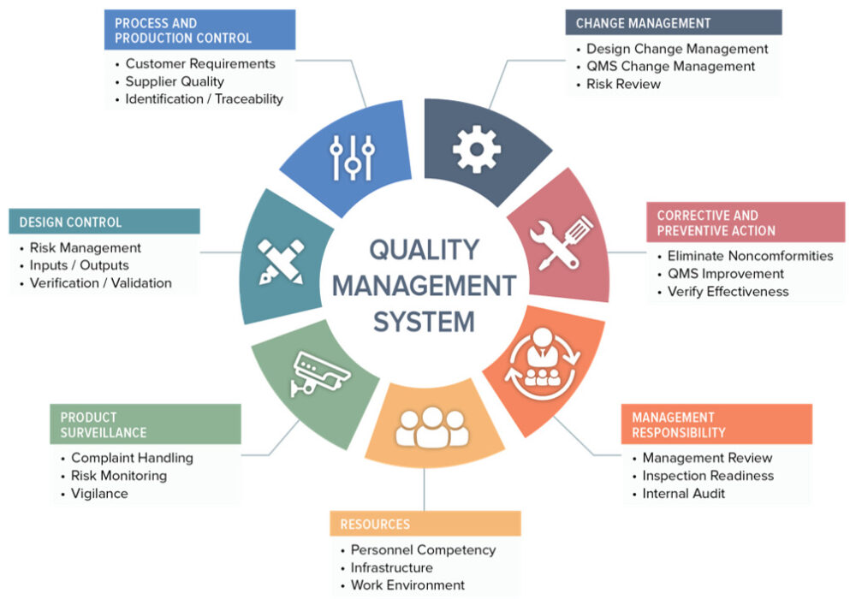
"We will implement a quality management system in accordance with ISO 9001 standards."
We will do.Translation: "With guaranteed provision"Commitment and Leadership Support To ensure the enhancement of quality and the provision of necessary resources.Please provide the Arabic text you would like me to translate into English.
"We will define the scope of the quality management system." To cover the relevant products and servicesIt appears that there is no Arabic text provided for translation. Please provide the text you would like me to translate, and I will be happy to help!
We will analyze the current situation. To identify the gaps between the current system and the requirements.ISO 9001. (Note: The term "ISO 9001" is a widely recognized international standard for quality management systems and does not require translation.)
"We will develop a quality policy and quality objectives." "that align with the objectives"The term "الهيئة" can be translated to "the Authority" or "the Body," depending on the context in which it is used. If you have a specific context or sentence in which this term appears, please provide it for a more precise translation.It seems that you have not provided the Arabic text for translation. Please share the text you'd like me to translate, and I'll be happy to assist you!
We will prepare the documents and procedures. "which include the quality manual, work procedures, and quality records"Of course! Please provide the Arabic text you'd like me to translate, and I'll be happy to assist you.
We will carry out the procedures. To ensure compliance with the requirementsISO 9001. (Note: "ISO 9001" is an internationally recognized standard for quality management systems, and it remains the same in both Arabic and English. No translation is needed as it refers to a specific standard.)
We will train the employees. To empower them to implement the standards and understand their role in achieving the objectives.It seems that you haven't provided any Arabic text for translation. Please share the text you'd like me to translate into English, and I'll be happy to assist!
"We will conduct internal reviews." RegularlyTo ensure the effectiveness of the quality management system.Please provide the Arabic text you would like me to translate, and I will be happy to assist you!
We will prepare for the external review. To obtain the accreditation certificate.It seems you haven't provided the Arabic text you'd like me to translate. Please share the text, and I'll be happy to assist with the translation to English, maintaining the original nuance and context.
Translation: We will strive to achieve.Continuous Improvement "Through regular reviews and performance analysis."It seems there is no Arabic text provided for translation. Please provide the text you would like translated, and I'll be happy to assist you!

Slide 24
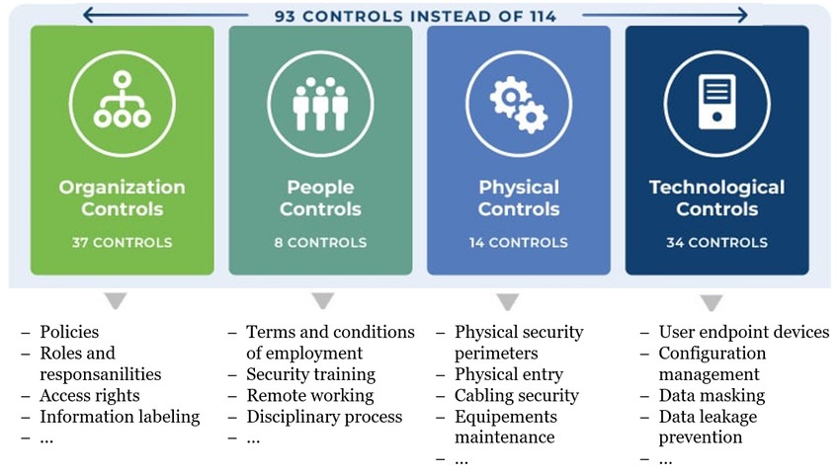
We will also implement an Information Security Management System in accordance with ISO 27001 standards.
The application of the standard will assist the authority in:
Protecting the confidentiality, integrity, and availability of information.
Reducing security risks and ensuring business continuity.
Compliance with local and global laws and regulations regarding data protection.
The application steps include:
Identification of informational assets and risk assessment.
Implementation of appropriate protective measures.
Monitoring and periodically improving the system.

Slide 25
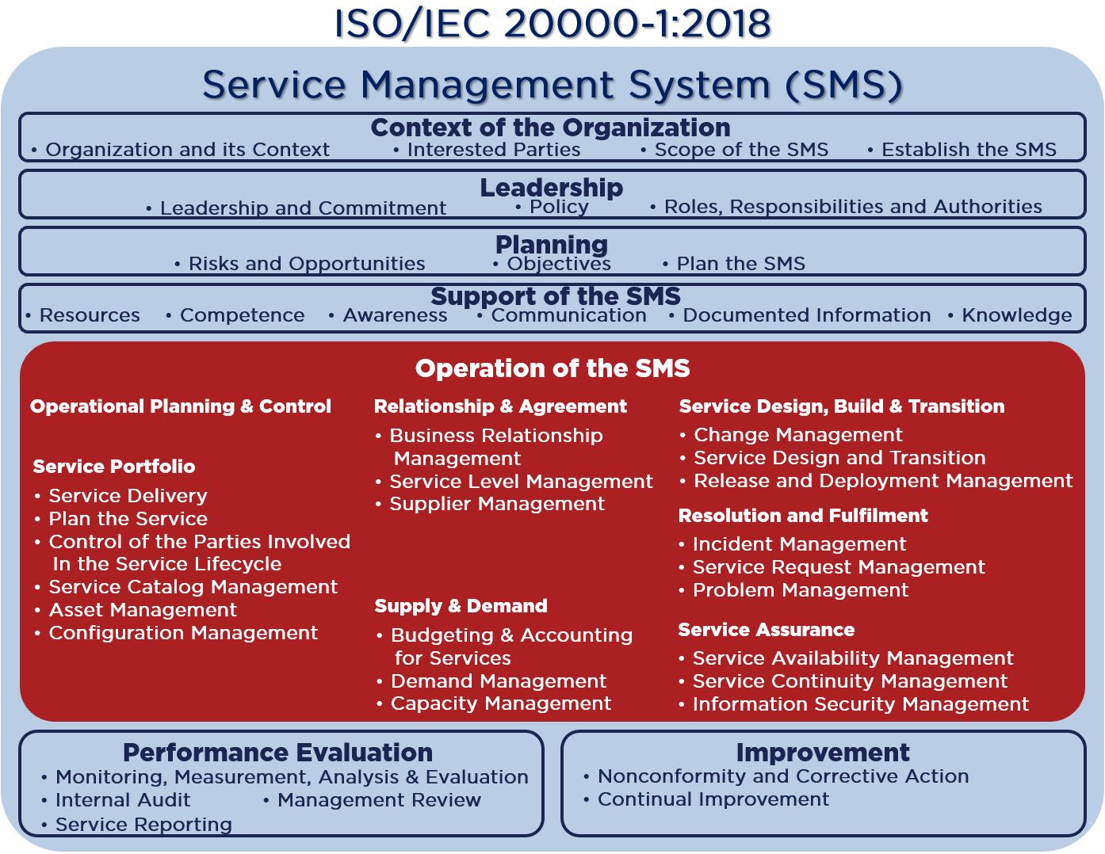
"We will also implement an IT service management system in accordance with ISO 20000 standards."
The application of the standard will assist the authority in:
Improving the quality of servicesTranslation: Ensuring that the services provided meet the requirements of the clients.
Increase in efficiencyImproving internal processes and increasing the effectiveness of IT service management.
Compliance with StandardsCompliance with the required regulations and industry standards.
Improving Customer Satisfaction"By providing services that are characterized by reliability and continuity."
The steps for implementation include:
Analysis of the Current Situation of Services"and identifying the necessary improvements."
Implementation of appropriate procedures for service management.According to the requirementsISO 20000.
Monitoring and Reviewing PerformanceTo ensure continuous improvement

Slide 26
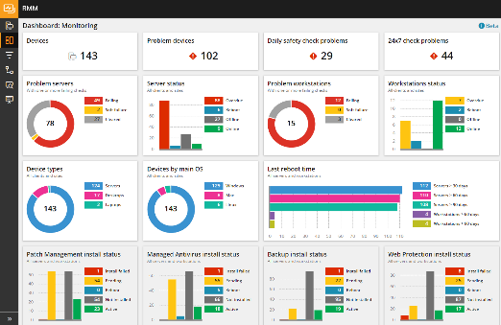
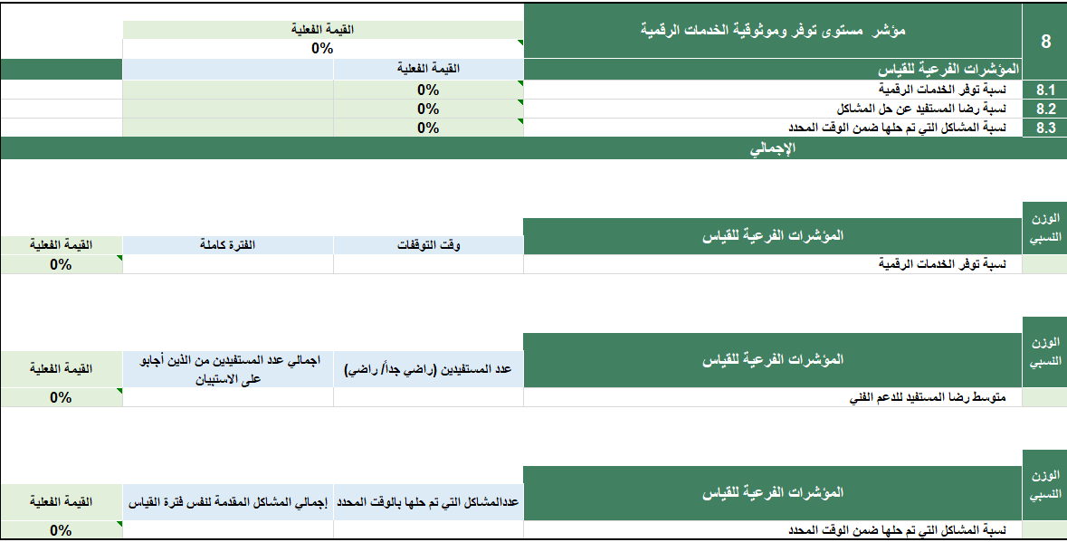
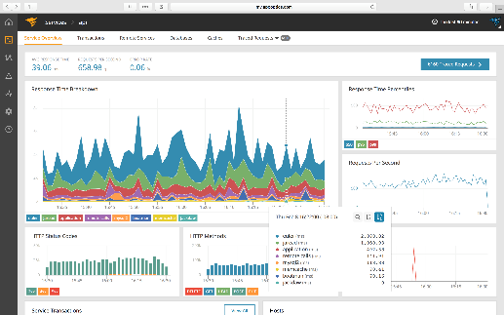
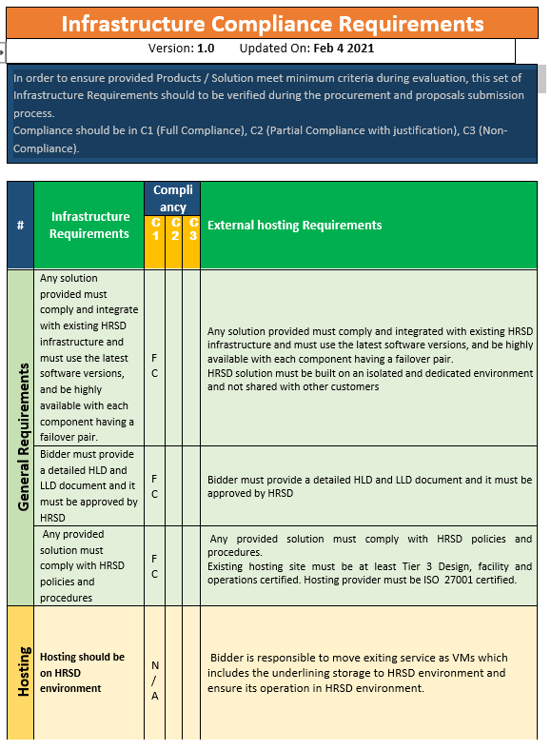
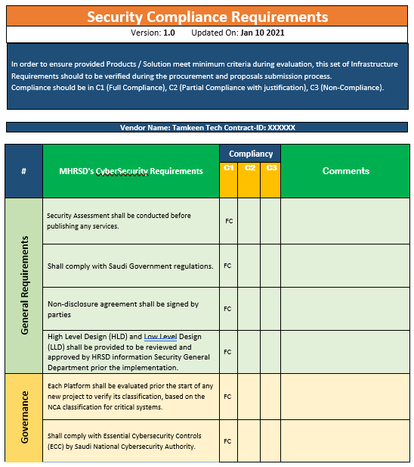
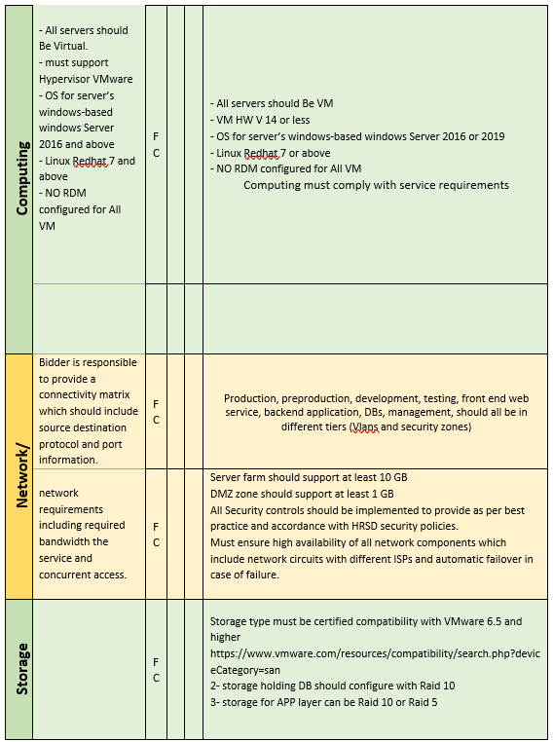
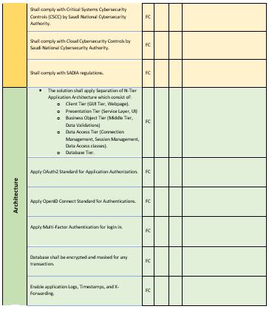
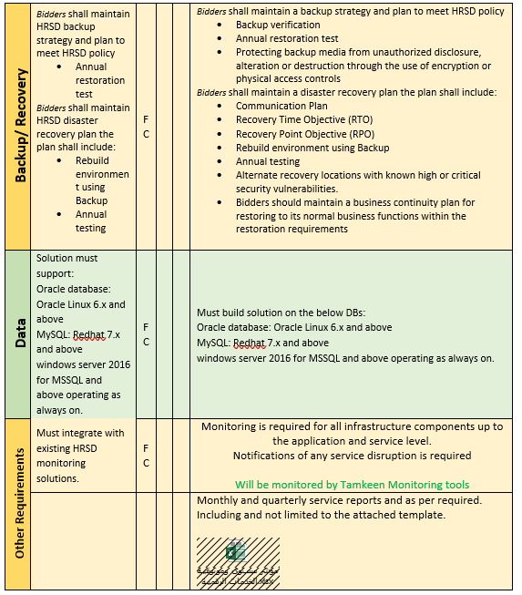
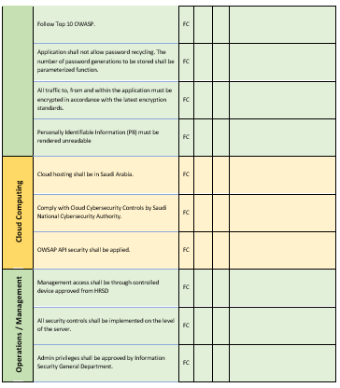
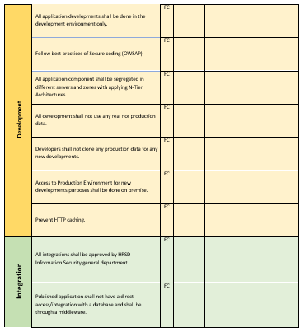
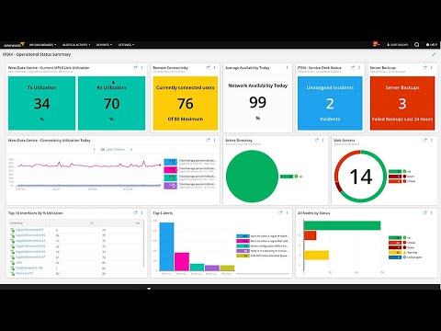
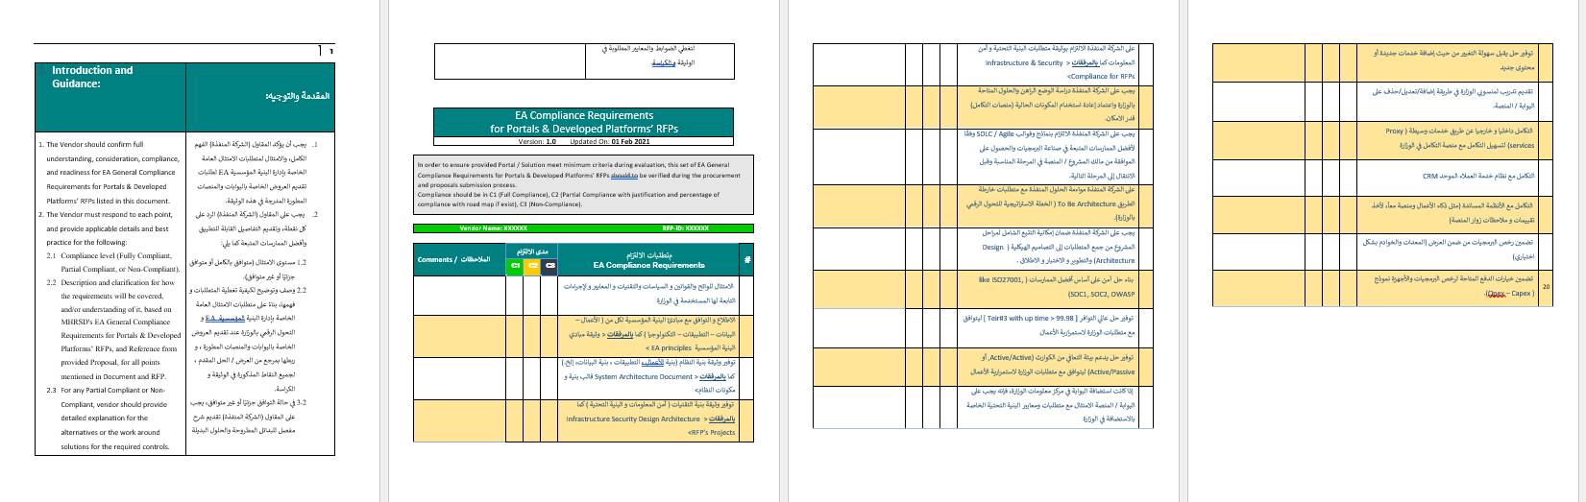
We will also operate the technical systems according to best practices and global standards.
Supporting Tools for Cloud Infrastructure Monitoring
Tools and Methodologies Used in Governance
"And we will use a set" Methodologies and tools for monitoring performance indicators to ensure reliability and availability.
Illustrative example
Illustrative Example

Slide 27

Periodic reports will also be issued to monitor the progress of the work.
Report Frequency
Report Description
Report Title
Quarterly
A report outlining the status of deliveries based on their schedule.
The timeline and delivery plan
Weekly
A report outlining priority tasks and their potential risks.
Priorities and Risks
The Arabic word "شهري" translates to "monthly" in English.
Report outlining the names and roles of the Human Resources for the upcoming period.
Human Resources Plan
Translation: "My monthly"
Report Clarifying the Current Human Resources Commitment to Working Hours
Human Resources Work Schedule
"Monthly"
Report on the Status of Task Completion
Workflow
Quarterly
Report detailing the status of training sessions.
Training Plan

Slide 28
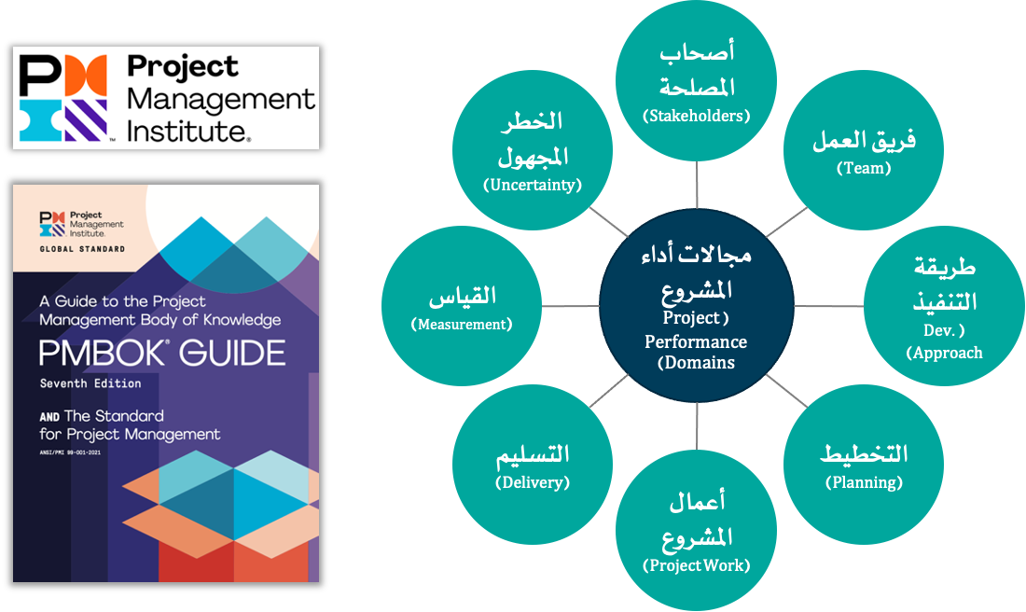
Project Implementation Methodology - Project Management Methodology
The methodology adopted for managing consulting and technical projects related to the company is based on the principles of the latest release (the seventh edition) of the project management methodology.PMBOK Translation: PMBOK (Project Management Body of Knowledge)"issued by the Project Management Institute"PMIMethodology.PMBOK (Project Management Body of Knowledge)"It is the globally dominant methodology in project management, and in its seventh edition, eight project performance domains have been adopted."Project Performance Domains"They are essential groups for all types of projects that are interconnected. When managing any project, it is necessary to choose a number of processes/methodologies."Methods"The tools"Artifacts"Supporting and influencing all eight project performance areas."
Unknown Risks
Stakeholders
Measurement
Translation: The team.
Areas of Project Performance
Submission
Method of Implementation
Project Activities
Planning

Slide 29

Project Implementation Methodology – Proposed Workflow for Project Execution According to Project Management Methodology.
"In accordance with the project management methodology issued by the Project Management Institute."PMIBased on our previous experience in this type of consulting projects.And technology.The translation of the Arabic text "والخبرة في العمل في" is: "And the experience in working in"Similar ProjectsIn the Kingdom of Saudi Arabia, and in accordance with the nature of the project we will be implementing, the work on this project will proceed according to the following workflow:
Surveillance and Control
Monitoring the project's activitiesMonitoring project costs, budget, and performance indicators / issue management / risk management / taking corrective actions
Project Completion
Project Implementation
Project Planning
Project Initiation
Completion of the Project
Delivery of Documents and Papers
Documenting the Lessons Learned
Termination of the Contract
Formation of the Project Team
Project Task Execution
Project Output Management
Quality Management
Developing the work plan, including resources and a mechanism for division of labor.
Developing a Communication Plan
"Developing Risk Mitigation Plans"
Governance and Project Management
Project Initiation Presentation
Project Charter Development
Defining the scope of work in the project
Identifying Potential Risks
Establishing special protocols for the project.

Slide 30
Project Implementation Methodology - Proposed Work Flow for Project Execution - Project Initiation Phase
Objectives
Tasks
Determining and approving project management mechanisms and having them endorsed by the authorities overseeing the project.
"Establishing and adopting a project governance framework and the periodic meetings for monitoring the project's implementation."
Proactivity in managing the risks that the project may face.
Preparation of the project management methodology in alignment with the client's approved methodology, to ensure project governance in a systematic manner, with the following core components identified as a minimum:
Project DocumentProject CharterIt seems that there is no Arabic text provided for translation. Could you please share the text you would like me to translate?
"Scope of Work Document"Project Scope of WorkIt looks like there is no Arabic text provided for translation. Please provide the text you'd like translated, and I'll be happy to assist you!
"Communication Plan Document"Communication PlanIt seems that you did not include the Arabic text you would like translated. Please provide the text, and I'll be happy to assist you with the translation!
Risk Management DocumentRisk Management PlanIt seems that you did not provide any Arabic text to translate. Could you please share the text you would like me to translate into English?
"Problem Management Document"Issues Management PlanIt seems like the Arabic text you intended to provide is missing. Please share the text you would like me to translate, and I'll be happy to assist you!
Identification of the key stakeholders in the project.Project Stakeholders"It is necessary to involve them in the project to accomplish the outputs and tasks related to the project."
"Defining the project team (from the company and from the client) and determining the responsibilities and authorities of the teams."
"Establishing a Project Governance Framework"Project Governance Framework"Establishing the project's steering committees, their authorities, and the schedule for follow-up meetings on project implementation."
Credits
The overseeing entity for the project will review the proposals and work collaboratively with the consulting team to reach the final format of the project's governance framework.
The reliance of the supervising entity on project governance and management documents.
Outcomes
Project Management DocumentsProject Charter, Risk Management Plan, etc.It seems that there was a mistake, as the Arabic text you intended to provide is missing. Could you please share the text you'd like me to translate?
Project Governance FrameworkProject Governance FrameworkIt looks like you didn't include the Arabic text that you would like translated. Please provide the text, and I'll be happy to assist you!

Slide 31
Project Execution Methodology - Proposed Workflow for Project Implementation - Project Planning Phase
The goals
Tasks
Develop a project plan that includes tasks assigned to the consulting team as well as tasks related to other parties (the project oversight body, beneficiaries, etc.).
Containing reliance on other parties to ensure the project is completed within the approved timeframe.
Preparation of the detailed project plan by dividing the project into phases that align with the proposed methodology for project implementation, while focusing on the following points:
Defining tasks related to communication with stakeholders and participation in the project (such as, but not limited to, meetings with beneficiary departments or external beneficiaries) and in accordance with the agreed-upon advance time necessary for communicating with internal and external parties as per the approved communication plan.
Defining tasks related to reviewing the outputs in agreement with the supervising entity of the project, to ensure that the project plan includes the necessary timeframes for output review.
Defining tasks related to updating the outputs after their review by the project oversight authority, to ensure that the project plan includes the necessary timelines for updating the outputs.
Project planning for early completion (a timeframe shorter than the official duration set for the project) allows for potential extra time in case there is a need for a longer period to review or update the outputs or any other tasks that require more time than originally planned. This way, the possibility of completing the project within the official timeframe remains viable.It seems there is no Arabic text provided for me to translate. Please share the text you would like me to translate, and I will be happy to assist you!
The translation for "الاعتمادات" is "Credits." However, if this term is used in a specific context, such as in finance, education, or another specific field, it could also refer to "Accredits" or "Authorizations." Providing additional context would allow for a more precise translation.
The entity supervising the project is reviewing the proposed plan for its implementation and working collaboratively to reach the final version of the project implementation plan.
"Reliance of the supervising body on the project implementation plan."
Outcomes
Project Implementation Plan (Project ScheduleIt appears that the text you intended to share for translation is missing. Please provide the Arabic text you'd like translated, and I'll be glad to assist you!

Slide 32
Methodology for Project Implementation - Proposed Workflow for Project Execution - Project Implementation Phase
Objectives
Tasks
Executing project activities in accordance with best practices and methodologies to achieve the client’s strategic objectives, exceed expectations, and build a value-added strategic partnership for both the client and the company.
Implementation of the main tasks outlined in the specifications and scope of work in accordance with the methodologies and proposed solutions presented in our proposal.
"Implementing project management execution plans and adhering to the schedule."
Providing a qualified onsite team and executing the project work according to standard methodologies for analysis, re-engineering processes, infrastructure, technical solutions, development, testing, and deployment.
Implementation of Risk Management Plans
Implementation of Quality Management Plans
Implementation of communication plans and reporting on the achievements of the tasks.
Knowledge Transfer
Approvals
The supervising authority for the project
Outputs
Periodic reports (monthly and quarterly) on completed work.
Business and System Requirements Analysis DocumentsBRD, SRSIt seems that the Arabic text you wanted to have translated is missing. Please provide the text you would like translated, and I’ll be happy to assist you!
Technical Architecture and Infrastructure DocumentsThe text you provided consists of abbreviations or acronyms that might stand for specific terms or phrases. However, without additional context, it is difficult to provide an accurate translation. In many contexts, these could refer to: - SAD: Seasonal Affective Disorder - HLD: High Level Design / Hold - LLD: Low Level Design / Long Latency Delay If you can provide more context or clarify what these abbreviations refer to, I would be glad to assist you further in translating or explaining them.It seems that there is no Arabic text provided for translation. Please share the text you would like me to translate, and I will be happy to assist you!
Test Documentation (Test Cases and Scenarios, Test Execution Reports)

Slide 33
Methodology for Project Implementation - Proposed Workflow for Project Execution - Monitoring and Control Phase
The goals
The translation of "المهام" is "Tasks."
Preparation of monitoring and control plans, compliance standards, and performance indicators.
Implementation of measurement, monitoring, review, and reporting.
Taking the necessary corrective actions in case of deviation from the established path for project implementation.
It seems that the Arabic text you provided is incomplete as it ends abruptly with "نهتم في هذ," which translates to "We care about this." However, without more context or the completion of the sentence, it's challenging to provide a full translation. If you can provide the complete text or additional context, I would be happy to assist you further.It seems that your input might be incomplete, as "ه" is just a single Arabic letter (the letter "h"). If you have a specific text or phrase you would like translated, please provide the complete text, and I'll be happy to assist you!The stage ensures the completeness, accuracy, and effectiveness of all project results through the establishment of a clear review and approval process.
Providing an overview of the monitoring and control process, including a description of the methodologies, tools, and activities involved.
Description and identification of participants in the monitoring and control process, the necessary roles and teams, and the specification of required meetings and their frequency.
Determining Compliance RequirementsAnd greetings.The project that will be implemented.The project's outputs will be evaluated against these criteria before they are officially approved.
Preparing the timeline, resources, methods, and procedures that will be used in conducting project reviews.
Determining the outputs and practical metrics that will be captured and monitored for the project, as well as any tools that will be used to accomplish this.
Implementation of monitoring and control, measuring compliance, reporting, and assessing performance indicators.
"Implement corrective plans in case of deviation from the execution plans or failure to adhere to them."The term "الامتثال" translates to "compliance" or "obedience" in English. It refers to the act of conforming to rules, laws, or requests. The context in which it is used can influence its specific meaning, but it generally carries the connotation of following directives or adhering to established norms."With the requirements or the failure to achieve the desired performance indicators, and ensuring their implementation and realigning the project on the correct path."
Credits
The supervising authority of the project
Outcomes
Periodic reports for monitoring, control, and compliance with the project's outputs.

Slide 34
Methodology for Project Implementation - Proposed Workflow for Project Execution - Project Closure Phase
The goals
Tasks
Complete handover of the project works to the concerned team by the client.
The delivery of all evidence, documents, files, and illustrations related to the project.
The project will be closed upon the completion of all required work according to the terms of reference and specifications, as well as the scope of work.
The essential requirements are delivered as outlined in the table:
Credits
Essential Deliverables | Sure, please provide the Arabic text you would like me to translate.
"Analysis, documentation, re-engineering of processes, and preparation of system requirement documents."The text you provided only contains the abbreviation "BRD" without any additional context or content. Could you please provide more text or clarify what "BRD" refers to? This way, I can assist you better with a suitable translation.It seems like the Arabic text is missing from your request. Please provide the Arabic text you'd like me to translate so I can assist you accurately. | It seems that the text you want translated is not provided. Please share the Arabic text you'd like me to translate, and I'll be happy to assist you!
"Analysis and documentation work as well as the preparation of system requirements documents."It seems that "SRS" does not appear to be Arabic text or does not provide information prompting a translation. If you could provide the full Arabic text that you would like to have translated, I would be happy to assist you!It seems that there is no Arabic text provided in your request. Please provide the Arabic text you would like me to translate into English, and I will be happy to assist you! | It seems you have not provided any Arabic text for translation. Please provide the text you would like translated, and I'll be happy to assist you!
Developmental works for systems and services for web applications. | It seems that you've provided "3" without any accompanying Arabic text to translate. Please provide the actual Arabic text you would like me to translate, and I'll be happy to assist you!
Developmental work for services regarding smart device applications. | It appears that there is no Arabic text provided for translation. Please provide the Arabic text that you would like me to translate into English, and I will be happy to assist you.
Design work for infrastructure solutionsSolution ArchitectIt seems you've accidentally left the Arabic text out of your request. Please provide the Arabic text you would like translated, and I'll be happy to assist you! | It seems you may have entered just the number "5" without any accompanying text. If you have a specific Arabic text you'd like translated into English, please provide it, and I'll be happy to assist you!
Quality control work for services and systems for smart device and web applications. | It seems that you have only provided the number "6". If you have a specific text or phrase you would like me to translate from Arabic to English, please share it, and I'll be happy to help!
The overseeing entity for the project.By the client
Project Manager and Project Management OfficeIt seems there isn't any Arabic text provided for translation. Please share the text you would like me to translate, and I'll be happy to assist you!
Outputs
Project Closure Document

Slide 35
We will utilize our managed services model in the execution of the project.
Through our managed services, we provide comprehensive solutions in the field of information technology that meet our clients' requirements. We have extensive experience in creating and operating technical infrastructures such as networks, systems, storage media, cybersecurity, system and application development, as well as technical and IT support, which enables us to offer holistic solutions.
Our managed services revolve around key performance indicators and service level agreements that are defined and approved in collaboration with our clients.
Our managed services provide the following value-added offerings to our clients.
Client's focus on their core competencies.
It seems like there's no Arabic text provided for translation. Please share the specific text you would like translated, and I'll be happy to assist you!
Good management of services
It seems that there was no Arabic text provided for translation. Please provide the text you would like me to translate, and I will be happy to assist you!
It appears that you've provided the number "2" without any accompanying Arabic text to translate. Please provide the Arabic text you would like translated, and I will be happy to assist you.
"Anticipate the client's performance more accurately."
Cost reduction
It seems that your request is missing the specific Arabic text to be translated. Please provide the Arabic text you'd like me to translate, and I'll be happy to assist you!
It seems that you've entered "3" instead of the Arabic text you want to be translated. Please provide the Arabic text, and I'll be happy to help with the translation!
Launching new services faster and more cost-effectively.

Slide 36
Our managed services are distinguished by (1/2) ...
Supplier Management
Operations Management and Development
Supervisor of WorkService Delivery ManagerIt seems you did not provide the Arabic text that you would like me to translate. Please share the text, and I will be happy to assist you with the translation!
Methodology for Providing Managed Services
We manage the escalation of reports, issues, and incidents with the suppliers according to the approved service level agreements. We conduct diligent and continuous follow-up on the escalated reports until they are resolved and services are restored or the security of the services is reinstated and vulnerabilities are closed.
We rely primarily on the standard IT service management methodology in executing managed services.ITIL4 (Note: "ITIL4" is a recognized framework in IT service management and does not require translation as it is an acronym. It remains the same in both Arabic and English.)Our services include comprehensive management of current employees, the operations and technical components of information systems, supplier management, change management and quality assurance, business continuity, and continuous improvement of processes.
We appoint an operations manager to handle daily operations and managed services, distribute tasks, respond to requests and notifications, follow up on them, and meet the requirements of the service level agreement.The term "SLA" could refer to several concepts depending on the context, such as "Service Level Agreement" in a business context. If you provide the full Arabic text or context in which "SLA" appears, I would be happy to provide a precise translation!"It surpasses expectations and targets, and the client manager issues reports on compliance with the terms of the Service Level Agreement and periodic performance reports."
The General Administration of Operations and Maintenance at the company oversees the implementation of managed service projects, focusing on delivering services according to the best methodologies while achieving complete customer satisfaction.

Slide 37
Our managed services are characterized by (2/2) ..
Quality Assurance
Service Level Agreement
Human resources with competence
Technical Support
We ensure complete compliance with the quality assurance standards and guidelines set forth in our methodology for project implementation and management, which is based on international project management and quality management methodologies.
The Service Level Agreement (SLA) is the cornerstone of managed services and a benchmark for measuring the success of our service delivery and achieving customer satisfaction. In the initial phases of the project, we prepare the SLA and obtain the client's approval, after which it serves as the reference for executing tasks, preparing reports, and measuring actual performance indicators. We are always striving for continuous improvement and exceeding our clients' expectations.
We mobilize the necessary human resources with the required skills and competencies to carry out the work. Our team includes a select group of consultants and engineers with globally recognized professional credentials in all the fields needed for the project. Additionally, we attract any necessary expertise as needed for the implementation of the project.
We provide comprehensive technical support services based on an IT service management methodology.ITIL 4The translation is: "We handle events." If you have any additional context or a longer text, I would be glad to assist further!IncidentsThe translation of the Arabic phrase " والمشاكل (" is "and the problems (". However, please note that this phrase appears to be part of a larger context, indicated by the parentheses. To provide a more accurate translation, I would need additional text or context surrounding it.ProblemsThe translation of "والطلبات" is "and the requests."Could you please provide the Arabic text you would like me to translate into English?"In accordance with the established procedures, we also perform maintenance and periodic updates following the specific guidelines for them, such as..."Configuration ManagementIt seems that the Arabic text is missing. Could you please provide the text you would like me to translate?Change ManagementIt appears that your message is incomplete. Please provide the Arabic text you would like to have translated, and I will be happy to assist you with an accurate translation.Release ManagementIt seems that you have provided a fragment or incomplete text ("، الخ.") which translates to "etc." in English. If you have more content or a specific passage you'd like me to translate, please provide it, and I'll be happy to assist!

Slide 38





"We will adopt our proven methodology in managing human resources within the scope of the project."
It appears that you haven't provided any Arabic text to translate. Please share the specific text you would like me to translate, and I'll be happy to assist you.
The human resources that will commence work on-site under this offer will operate as a team of dedicated staff under the management and supervision of the company, in coordination with the relevant department at the client.
It seems that there is no Arabic text provided for translation. Please provide the text you would like to have translated, and I'll be happy to assist you!
The company is committed to ensuring that the technical personnel possess recognized qualifications in their respective fields, in addition to the high competence that enables them to carry out the project work with the utmost quality and professionalism.
It seems that your request contains only the number "3" without any accompanying text to translate. Could you please provide the Arabic text you would like me to translate?
The company is committed to prioritizing the employment of Saudi citizens for the positions outlined in the brochure.
It seems that the text you provided is just the number "4." If you have more text that you would like translated from Arabic to English, please provide it, and I'd be happy to help!
The client has the right to conduct personal and technical interviews for the required personnel listed in the document, and the names of the candidates along with their qualifications are proposed by the company. The client has the right to accept or reject the candidate without providing reasons.
It seems that you entered "5" without any accompanying Arabic text to translate. Please provide the Arabic text you would like to have translated, and I'll be happy to assist you!
The employees who are selected and appointed by the client are committed to carrying out their work under the guidance of the person responsible for overseeing the contract with the client. Instructions must be issued within the scope of work outlined in our proposal according to the job description.

Slide 39





"We will rely on our proven methodology in managing human resources within the scope of the project."
It appears that you've only provided the number "6" without any additional Arabic text to translate. Could you please provide the specific Arabic content you would like translated?
In the event that the client needs to hire new employees to complete the team or to replace an employee due to incompetence, poor behavior, or excessive absenteeism, as well as in case of the termination of any employee currently in service, the company is committed to hiring a replacement within a maximum of 30 working days based on the client's instructions. This will follow the same process for advertisements, nominations, interviews, and acceptance as agreed upon with the client. If this does not occur, the client has the right to appoint a suitable candidate through the company, provided that the costs remain within the limits specified in the pricing table for the operational team included in our financial proposal.
It appears that only the number "7" has been provided for translation. If you have a specific phrase, sentence, or passage in Arabic that you would like translated into English, please share that text, and I would be happy to assist you!
During the first three months from the date the employee starts work, the client has the right to dismiss them if their unsuitability for the position is proven. The client is obligated to notify the company of the dismissal request at least 30 working days in advance.
It seems like you provided just the number "8" without any accompanying Arabic text to translate. Please provide the Arabic content you would like translated, and I'll be happy to assist you!
In the event that a team member is absent for an extended period due to an emergency or medical leave, the company is obligated to provide a substitute with the same terms and specifications.
It seems there may have been a misunderstanding, as the text you've provided is simply the numeral "9". If you meant to provide additional text in Arabic for translation, please do so, and I'd be happy to assist you with that.
Employee vacations: The company offers its employees official annual leave of (It seems that you've entered only the number "22." If you intended to provide a longer piece of Arabic text for translation, please share that text, and I'll be happy to assist you with the translation!"One day, the agreed-upon cost will not be affected by the employees' days off that the employee receives."
It seems that there may have been a mistake, as "10" does not provide any context or content to translate. If you have a specific Arabic text you would like me to translate, please provide it, and I'll be glad to assist you!
In the event that it is necessary to replace an employee, the company will need 30 working days to complete the replacement.

Slide 40





"We will rely on our proven methodology in managing human resources within the scope of the project (3/4)."
It seems that the text you provided is just the number "11" and does not contain any Arabic text to translate. If you have specific Arabic text you would like translated into English, please provide that, and I'll be happy to assist!
In the event that an employee wishes to cease employment, they will be replaced by another employee to fill their position, and the company will oversee the process of ensuring the transfer of knowledge from the departing employee over a period of two calendar months.
It appears that you have entered the number "12" without providing any accompanying Arabic text for translation. If you have a specific Arabic text you would like translated into English, please provide the text, and I will be happy to assist you with the translation.
To renew the employees' contract period, the client will notify the company of the desire to renew at least 30 working days before the end of the current period, at which point both parties will sign a new contract.
It seems you've provided the number "13" without any accompanying Arabic text to translate. Please provide the Arabic text you'd like translated, and I'd be happy to assist you!
The source code, along with business ideas, methodologies, and knowledge acquired during the contract period, is considered intellectual property owned by the client.
It seems that you have only provided the number "14" without additional Arabic text to translate. Could you please provide the specific Arabic text you would like to have translated?
The project manager from the company meets regularly with the client’s representatives to evaluate employee performance and monitor implementation and collections.
It seems you've only provided the number "15" without additional context or text to translate. If you have a specific Arabic text that you would like me to translate into English, please share it, and I'll be happy to assist!
The employee's (employees') working hours will be determined based on the client's working hours and the labor laws in effect in the Kingdom.

Slide 41



"We will adopt our proven methodology in managing human resources within the scope of the project (4/4)."
The text "16" does not contain any additional context or content to translate. If there is more text you'd like me to translate, please provide it, and I'll be happy to assist!
The client agrees that during the contract period and for one year after the termination of the agreement, the client will not seek to employ the company’s employees. In the event that such a desire arises, employment will not proceed without prior written consent from the company.
It seems that there is no Arabic text provided for translation. Please provide the text you would like me to translate, and I'll be happy to assist you!
Employee Leave: The company provides its employees with official annual leave of (21) days. The agreed-upon cost presented to employees will not be affected by the vacation days that the employee takes.
It seems that the text you provided is just the number "18." If there is more text or specific content you would like me to translate, please provide that, and I'll be glad to assist!
Employees working under this offer must utilize their vacation balance before the end of the contract year, following the company's vacation policy as a reference framework.
It looks like you've provided the number "19" without any accompanying text for translation. Please provide the Arabic text you would like me to translate, and I'll be happy to help!
The company provides the necessary training for employees to perform their job duties and build their skills in accordance with work requirements and as agreed upon with the client.
It seems that you've provided the number "20" without any accompanying text to translate. If you have specific Arabic text that you would like translated into English, please provide it, and I'll be happy to assist you with an accurate and nuanced translation.
The company provides health insurance benefits according to the approved tiers that align with job levels, company policies, and as per the agreement with the client.

Slide 42
Executive Summary
Scope of Work for the Project
Project Implementation Methodology
The project implementation timeline
The organizational structure and the team.
Project Assumptions
About the Digital Future Company
Our Clients
Our Projects
42

Slide 43
Project Timeline
The Fourth Year |  |  |  | The third year |  |  |  | The second year |  |  |  | The First Year |  |  |  | The Year
The Fourth Quarter | The third quarter | The second quarter | The first quarter | The Fourth Quarter | The third quarter | The second quarter | The First Quarter | The Fourth Quarter | The third quarter | The second quarter | The first quarter | The Fourth Quarter | The third quarter | The second quarter | The first quarter | The Phase
 |  |  |  |  |  |  |  |  |  |  |  |  |  |  |  | Assessment
 |  |  |  |  |  |  |  |  |  |  |  |  |  |  |  | Operation
 |  |  |  |  |  |  |  |  |  |  |  |  |  |  |  | The translation of "التسليم" to English is "Submission." However, depending on the context it can also refer to "Delivery" or "Handing Over." If you can provide more context, I can offer a more specific translation tailored to its intended meaning.
On-the-job guidance

Slide 44
Executive Summary
Project Scope
Project Implementation Methodology
Project Implementation Timeline
Organizational Structure and Teamwork
Project Assumptions
About Future Digital Company
Our clients
Our Projects
44

Slide 45
The company brings together a wide range of local and global expertise, which will be utilized to achieve the desired impact of the project.Of course! Please provide the Arabic text you'd like me to translate, and I'll be happy to assist you with it.
Muhannad Fahd Al-Mushari
Rana Khalil
Mohammad Adnan is an interrogator.
Najib Nasser
Data Analyst
Quality Management Consultant
Business Continuity and Cybersecurity Consultant
Specialist in Institutional Structure
Ramzi Ahmed
Anas Nabulsi
Specialist in Technical Asset Management
SpecialistITIL Translation: ITIL (Information Technology Infrastructure Library) (Note: "ITIL" is an acronym used internationally in the field of IT management and does not require translation.)
Of course! Please provide the Arabic text that you would like me to translate into English.Translation: in addition toIt appears that the text consists solely of the number "12." Please clarify if you meant to provide additional text for translation or if you need further assistance!"Human resources available in the authority as mentioned in the appendix."The provided text "KAPT-DI-ITSM-RFP)" does not seem to be in Arabic—it looks like an acronym or a code. It could possibly stand for a specific project or proposal. If you have an Arabic text that you would like to have translated, please provide that, and I will be happy to assist you!It seems like you've provided a single word, "بند," which translates to "item" or "clause" depending on the context. If you have more text or a specific context in which this word is used, please share it, and I’ll be happy to provide a more accurate translation. It seems that the text you provided, "7.2," is a numerical reference rather than a piece of Arabic text to translate. If you have any specific Arabic text you would like to translate, please provide it, and I'll be happy to assist!They will be targeted for recruitment to work within the project's scope.ComprehensivelyCIO, CTO (Note: "CIO" stands for Chief Information Officer and "CTO" stands for Chief Technology Officer. These terms are commonly used in English and do not require translation.)

Slide 46
Education Master of Business Administration (MBA) - University of South Wales, UK Bachelor of Computer Information Systems - Al Hussein Bin Talal University, Jordan شهادات Translation: Certificates TOGAF 9 Certified Level COBIT® 5 Foundation ITIL® V3 Foundation PRINCE2® Practitioner CDMP Associate | Academic Qualifications and Professional Certifications | Najeeb Nasser EA Specialist
Director, Digital & Transformation Practice – Digital Future تطوير وتنفيذ استراتيجيات التحول الرقمي، قيادة فرق متعددة التخصصات لتحقيق الأهداف الاستراتيجية ودفع أجندة التحول الرقمي. Foster robust relationships with clients, deliver customized digital solutions, and promote the adoption of innovative technologies to remain at the forefront of emerging digital trends. Oversee project implementation, ensure timely delivery within budget constraints, and mentor high-performing teams while fostering a collaborative environment and continuously optimizing processes. Senior Manager - Elixir, McKinsey & Company I led a BOT project for an Enterprise Project Management Office (EPMO) initiative for one of the major companies in Saudi Arabia. قاد إنشاء مكتب بيانات وطني في المملكة العربية السعودية. Participated in defining and implementing the cloud strategy in Saudi Arabia. Consulting Manager - Digital Future "استدام قيادة إنشاء وتشغيل مكتب مؤسسي لأحد الوزارات الرئيسية في المملكة العربية السعودية." Translation: "Led the establishment and operation of an enterprise office for one of the key ministries in the Kingdom of Saudi Arabia." I led an engagement to cascade the digital strategy and identified over 40 key initiatives and projects to support the strategic directions. قادت تأسيس وحدة للأمن السيبراني في جامعة كبيرة في المملكة العربية السعودية. Digital Solution Architect, Tamkeen Technologies The solution of the MVP or pilots was delivered and owned during the presales stage. Promoted innovative approaches to working by utilizing lean product acceleration, rapid prototyping, consumer insights, and data-driven decision-making. Understood the pain points and needs of Tamkeen's customers and proposed the most effective solutions. Promoted the implementation of digital engineering concepts, including DevOps, microservices-driven and cloud-native architecture, and full-stack modularization. Leveraged partnerships and alliances with leading technologies such as Pega, UiPath, and F5 (nginx). Maintained Tamkeen's presentations and proposals in line with current trends by leveraging insights from industry analysts, monitoring competitor activities, and considering the evolution of the industry ecosystem. Technical Project Lead, Saudi Customs (NCBS) قاد عملية التحديث لدمج المركز مع الجهات والكيانات الداخلية والخارجية باستخدام أفضل المعايير والتقنيات المتاحة في السوق. Supported digital transformation projects by assessing and proposing innovative solutions and technologies. Planned, executed, and completed solutions pertaining to both new and existing products, modules, and services. Participated in the EA (Enterprise Architecture) domain governance model covering Business, Application, Data, and Technology. Translation: Exchanging best practices and lessons learned, continuously updating the technical system architecture requirements in response to evolving technologies and staying informed about recent, current, and forthcoming vendor products and solutions. Recommended and participated in the development of architectural blueprints for relevant systems.It seems that there is no Arabic text provided for translation. Please provide the text you would like me to translate, and I would be happy to assist you! مدير فريق تطوير البرمجيات، تقنيات تمكين Translated: Conducted project planning and effort estimation. Conducted design and solution architecture. Participated in the preparation of the proposal. Managed the development team. Designed, developed, and implemented web services using Microsoft tools andIt seems you provided only the word "techniques" without the accompanying Arabic text. Please provide the full Arabic text you would like translated, and I'll be happy to assist you with the translation while preserving the original meaning and context. | Practical Experience

Slide 47
It seems that the Arabic text you provided is not complete, as it consists of a single letter ("ا"). If you have a specific text that you would like me to translate, please provide the full content, and I will be happy to assist you!For academic qualifications: Master's degree in "Data Science" – University of North Texas – Graduated in 2021. Master's in "Project Management" – University of Bolton – Year of graduation: 2019. Bachelor's Degree in "Information Technology" - Southern New Hampshire University - Year of Graduation: 2015. Professional certifications, Professional Data Management ProfessionalThe term "CDMP" does not provide enough context for translation, as it appears to be an acronym. If you can provide more context or details about what "CDMP" stands for or its usage within a specific field or context, I would be more than happy to assist you with an appropriate translation.It seems there is no Arabic text provided for translation. Please share the text you would like me to translate, and I will be happy to assist you! "Certified in IT Governance for Organizations"CGEITIt seems that you have not provided any Arabic text to translate. Please provide the text you would like translated, and I'll be happy to assist you! Certified Information Security ManagerCISMIt seems that there is no Arabic text provided for translation. Please provide the specific Arabic text you would like me to translate into English, and I'll be happy to assist you!Translation: ISO-9001, ISO-27001 Lead Auditor Professional Project ManagementSure, please provide the Arabic text you'd like me to translate."Agile Project Management"PMI-ACPIt seems that you haven't provided the specific Arabic text that you would like to have translated. Please share the text, and I would be happy to assist you with an accurate and nuanced translation into English. Risk ManagementThe Arabic text "RMP" does not provide sufficient context or content for translation. Could you please provide more information or the complete text you want to have translated?Translation: Business Analyst ProfessionalPMI-PBA Translation: PMI Professional in Business AnalysisIt seems that you haven't provided any Arabic text for translation. Please include the text you would like to have translated, and I'll be happy to assist you! | Educational Qualifications and Professional Certifications | Mohammed Adnan is an interrogator. Business Continuity and Cybersecurity Consultant
Data Management Consultant / Digital Future Company with the following responsibilities:It seems you haven't provided the Arabic text you would like translated. Please share the text, and I'll be glad to assist you with the translation.It seems there might be a misunderstanding, as "2023" is simply a numeral and does not require translation from Arabic to English. If you have any specific Arabic text you'd like translated, please provide it, and I will be happy to assist!"To"Current timeIt seems that the Arabic text is missing from your message. Could you please provide the text you'd like me to translate? Establishment and activation of data management offices within government entities and alignment with legislative bodies (National Data Management Office)We illuminateIt seems that you haven't provided the Arabic text you would like me to translate. Please share the text, and I will be happy to assist you with the translation! Activating digital transformation in government entities and complying with measurement requirements in government bodies. Of course! Please provide the Arabic text you would like me to translate into English.MeasurementIt seems that there is no Arabic text provided for translation. Please provide the text you would like me to translate, and I will be happy to assist you! Director of Information Technology and Infrastructure / National Center for the Development of Wildlife, with the following responsibilities: (2022"To"It appears there is no Arabic text provided for translation. Please provide the Arabic text you would like to have translated into English, and I will be happy to assist you!It seems that the Arabic text you intended to share is missing. Please provide the text you would like translated, and I'll be happy to assist you! Development of the infrastructure and establishment of the data center in the new building at the center. Developing procedures and services, enhancing the applications of digital transformation and automation, and improving the current infrastructure at the center. Director of Digital Transformation / National Center for Environmental Compliance Monitoring, among the following tasks:It seems you didn't provide the Arabic text you want to be translated. Please share the text, and I will be happy to help you with the translation!2020"To the time."It seems that you've provided a date (2022) without any accompanying Arabic text. Please provide the Arabic text you would like to have translated, and I'll be happy to assist you!It appears that there is no Arabic text provided for translation. Please share the specific Arabic text you would like me to translate, and I will be happy to assist you. Establishing and activating information technology and digital transformation at the center, and developing digital applications at the center. Development and implementation of digital transformation plans, automation of services, and the introduction of necessary projects to achieve them. Cybersecurity Director - Assigned / General Authority for Meteorology and Environmental Protection, with the following responsibilities: (The Arabic text you provided is simply "2018," which is a numeral and does not require translation. The English representation remains "2018." If you have additional text or context to be translated, please provide it!"To the time"The Arabic text you provided is simply the year "2020," which does not require translation. It is already understood as the same in English. If you have more text or specific content you would like translated, please share it with me!It appears that there is a formatting issue, and I cannot see the Arabic text you'd like me to translate. Please provide the specific Arabic text, and I'll be happy to assist you with the translation. Activating cybersecurity within the authority, managing security and safety, enabling access permissions, and developing systems. Implementing cybersecurity awareness and training programs within the authority. "Programmer and Project Manager for Environmental Inspection / National Center for Environmental Compliance Monitoring, with the following tasks: ("2015"To the time"The text you've provided is simply "2020," which does not require a translation as it is a numerical representation that holds the same meaning in both Arabic and English. If there is more context or additional text related to "2020" that you'd like translated, please share that, and I'd be happy to assist you!It seems that the Arabic text you intended to provide for translation is missing. Please share the text, and I will be happy to assist you with an accurate translation. "Developing and activating environmental inspection at the General Authority for Meteorology and Environmental Protection, and enhancing the environmental inspection system." Participation in the privatization of the authority and the activation of environmental centers. Project management with a value exceeding 300 million riyals. | Practical Experiences
"Projects for the preparation, design, structuring, and governance of data (Royal Commission for Jubail and Yanbu), where qualification was achieved to:" "Among the top 52 governmental entities in the Kingdom for activating the national data indicator."We illuminateIt appears that you have not provided the Arabic text you would like me to translate. Please include the text, and I will be happy to assist you with an accurate translation. A project to provide consulting services and support for the management of digital enablers (the Saline Water Conversion Corporation), where we have obtained: The CenterThe third"Among the top entities in activating emerging technologies at the national level." The Red Sea Exploration Project (National Center for Wildlife) and the acquisition of: 7 Recent Discoveries and Research in the Red Sea Approved by UNESCO The project to develop the new environmental system in the Kingdom (the General Authority for Meteorology and Environmental Protection) and to reach An ecosystem with one of the strongest environmental systems and regulatory frameworks in the world for the preservation of the environment. | Key Achievements | Current Job Title: (Job Title Writing) Writing the current company name of the employee

Slide 48

[BSc] | [Princess Sumaya University for Technology] – [1992] [1996] [Computer Science] [GPA:"Very Good"Please provide the Arabic text you would like me to translate into English. Certification Training ISTQB Advanced Level: Test Analyst (CT AL-TA) certification. Leadership Skills and Change Management. Fire Fighting & Fire Chemistry Risk Management Middle East and Neighboring Countries School on Internet Governance. Best Practices for Data Center Management. ISTQB Advanced Level: Test Analyst (CT AL-TA) training course. Certified Information Systems Security Professional (CISSP). ISTQB Advanced Level: Test Manager (CTAL-TM). Business and Technical Writing Course. Performance Management. Certified Ethical Hacker v8 at PSUT. Certified Software Tester - ISTQB Foundation Level. Agile Testing Practices in Toronto, Canada by SQE Training. HP Quality Center (QC - ALM) Quick Test Professional (QTP) Performance Center (LR). | Academic Qualifications and Professional Certifications | Rana Khalil Quality Management Consultant
Digital Future Oct 2022 - present Chief Quality Officer Polaris Technology, December 2021 – October 2022 Director of Quality Department Royal Scientific Society (RSS) November 1996 – November 2021 Director of the Training Center & Manager of Technical Training Director of the National Software Quality Assurance Center (NSQAC) Software Testing Manager – (NSQAC) National Software Quality Assurance Center Manager of the Jordanian Software Quality Testing Board (JOSTOB) Head of Business Solutions Division - Information & Communications Technology for Development (ICTD) | Practical experiences
"Taktikat" translates to "Tactics" in English. "Automate the services of the committees - General Authority for Competition" ERP - Institute for Research and Studies EM-Vat Platform - Algorithms Software House LLC E-Service Development Based on Rad Technology - MWMAUP Civil Status and Passport Department | E-Services Platform - CSPD E-Services Platform - Economic Cities Authority E-Service Development - Greater Amman Municipality | Highlights of Achievements | Current job title: (Writing the Job Title) Writing the name of the employee's current company

Slide 49

It seems you've entered "ا," which is a single Arabic letter that doesn't form a word or phrase. Could you please provide a complete sentence or text for translation?For academic qualifications: Bachelor's Degree in Mechanical Engineering – King Saud University – 2020. Professional Certifications: شهادة المحترف في تحليل البيانات Business Analytics Nanodegree Excel Skills for Business | Academic Qualifications and Professional Certificates | Mohannad Fahad Al-Mashari Data Analyst
Data Management Specialist / Royal Commission for Jubail and Yanbu, with the following responsibilities: (2023 to present) Participation in the establishment and activation of a data management office within the entity, in accordance with the guidelines set forth by the legislative bodies and in alignment with the necessary compliance requirements. Working on assessing the maturity of data within the entity according to the national data index (Nadi).It seems you have provided "NDI" without any accompanying Arabic text to translate. Could you please provide the Arabic text you'd like me to translate? This will allow me to assist you more effectively.It seems you haven't provided the Arabic text for translation. Please share the text you'd like to have translated, and I'll be happy to assist you! Conducting analyses on the quality of data sets and providing necessary recommendations to improve input processes. Supporting the team in complying with the measurement requirements from the perspective of government data. Translation: (Measurement). Contributing to the effective implementation of data management strategies and processes to ensure the accurate and reliable collection, storage, and analysis of data. Contributing to the classification of a set of data according to the criteria.The recommended or The advice. (Note: "الموصى" can refer to something that is recommended or advised. The precise translation may depend on the context in which it is used.)"From the Office of National Data Management." Data Analyst / National Center for Wildlife Development, with the following responsibilities: (September 2022 – August 2023) The translation of "التعامل مع" is "dealing with" or "interacting with," depending on the context.Power BI"And its features for creating dashboards and concise reports for stakeholders." In the direction. Working as a business data specialist to support the improvement and automation of the data collection process from various departments of the organization. Contributing to the creation of data schemas for the execution of business intelligence procedures on the data aggregated from the main business departments within the organization. Contributing to the development of data management policies at the center in accordance with the National Data Management Office. | Practical Experiences
Project for the preparation, design, structuring, and governance of data (Royal Commission for Jubail and Yanbu), where qualifications have been achieved to: "Among the top 52 governmental entities in the Kingdom for activating the national data indicator (Nadi’)." Active participation in the Digital Transformation Measurement Index 2024 within the framework of government data. "Raising the level of the authority in the evaluation issued by the Health Insurance Council." | Highlighted Achievements | Current Job Title: (Job Title Writing) Writing the current company name of the employee

Slide 50
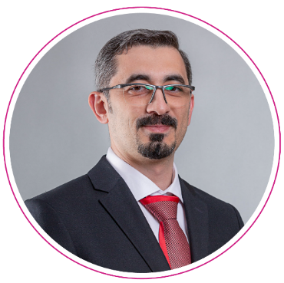
Academic Qualifications: "Information Systems Engineering, specializing in Software Engineering, Virtual Syrian University." Diploma in Computer Engineering, University of Damascus, Intermediate Institute of Computer Engineering Certified ScrumMaster (CSM) ITIL® Foundation Certificate in IT Service Management ISO 20000 Participant MCSA Web Applications MS: Programming in HTML5, JavaScript, and CSS3 Angular: The Complete Guide to Angular by Maximilian"Schwarzmuller" does not appear to be an Arabic term and may refer to a name or brand, possibly associated with a company specializing in trailers or logistics. If there is additional context or a specific Arabic text related to "Schwarzmuller" that you would like translated, please provide it, and I would be happy to assist! Ionic: بناء تطبيقات iOS و Android و الويب باستخدام Ionic و Angular بواسطة ماكسيميليانThe term "Schwarzmuller" appears to be a proper noun, likely a name or brand, and does not require translation. If it refers to a specific company, product, or person, it should be kept as is. If you would like to provide more context regarding "Schwarzmuller," I would be happy to assist further! | Academic Qualifications and Professional Certifications | Anas Nabulsia SpecialistITIL
The internal and external gates of the Eastern Health Assembly. System for Adjudicating Violations of Competition Law by the General Authority for Competition Automation system for business processes and digital transformation of internal services, Ministry of Economy and Planning (70 human resources services and services for departments and agencies). Unified Reporting and Dashboard PlatformThe provided text "MEP 360" appears to be a title or a specific term rather than a phrase in Arabic that requires translation. If "MEP 360" relates to a concept, subject matter, or specific terminology in a broader context, please provide additional context or the full Arabic text you'd like translated, and I would be happy to assist you with that translation.Ministry of Economy and Planning (Budget Dashboard, Finance, Contracts and Procurement, Project Management, Human Resources) Achievement Certificates System - Ministry of Economy and Planning, which has been delivered and launched at the Ministry of Rural Affairs, Municipalities, and Housing through an official letter addressed to the Ministry of Economy and Planning. "Preparation of the Ministry of Economy and Planning's Account in"Azure CloudIt seems that the text you provided consists only of the Arabic letter "و" which translates to "and" in English. If there’s additional text you would like translated, please provide that, and I’d be happy to assist!Office 365The translation of "وإجراء التكامل" is "and conducting integration." If you have more context or text surrounding this phrase, I would be glad to help refine the translation further!FederationThe phrase "بين الـ" translates to "between the." However, without additional context or information, this translation remains somewhat incomplete. If this phrase is part of a larger sentence, the meaning could vary. Please provide the complete sentence or additional context for a more accurate and nuanced translation.Local Active DirectoryIt seems there was an issue with the text you intended to provide for translation. You only included the letter "و," which translates to "and" in English but lacks context. Please provide the complete text you would like to translate, and I will be happy to assist you!Azure Active Directory "Securely deploying the applications of the Ministry of Economy and Planning and implementing single sign-on and two-factor authentication relying on the service."Azure Application Proxy"Facilitating remote work" Development and technical support for the internal and external portal, development of the G20 website, development of the international partnerships system - Ministry of Economy and Planning Creating a development and testing environment inAzure CloudFor Developers, Ministry of Economy and Planning. | Practical Experiences

Slide 51
Mansoura University, Bachelor of Commerce, Accounting, 2013 | Academic Qualifications and Professional Certifications | Ramzy Ahmed IT Asset Inventory Specialist
Project Management The term "Financial" translates to "مالي" in Arabic. If you require a more specific context or additional text related to financial matters, please provide that, and I will gladly assist with a detailed translation. SQL Translation: SQL (Structured Query Language) Analytical ORACLE CLOUD INFRASTRUCTURE BUSINESS ANALYSIS DATA ANALYSIS PROGRAM MANAGEMENT PAAS Extension المشكلة وحلها Translation: The problem and its solution Excellent knowledge of the interplay between Supply Chain Management (SCM) and Finance. Strong Technical Aptitude: A deep understanding of Oracle Cloud Supply Chain Management (SCM) modules, such as inventory management, procurement, order management, and Product Hub. Analytical and Problem-Solving Skills: Comprehending intricate supply chain processes, recognizing opportunities for enhancement, and delivering effective solutions. Possessing robust problem-solving abilities to tackle challenges encountered by clients and efficiently optimize supply chain workflows. Client-Focused Mindset: understanding the needs of clients, creating tailored solutions, and delivering projects within their defined scope and timeline. Adaptability and Continuous Learning: Being flexible and willing to embrace new technologies. مهارات إدارة المشاريع: بما في ذلك القدرة على التخطيط والتنظيم وتحديد الأولويات للمهام. Ability to understand Oracle Applications, troubleshoot issues as they arise in production, and document these issues in the Management Issue System. | Skills
Accenture United Arab Emirates, August 2021 – PresentPrincipal Consultant APPSPRO Saudi Arabia, October 2017 - July 2021Senior Consultant Impact Saudi Arabia, January 2017 - September 2017 Experienced Consultant JEHAN Recruitment Saudi Arabia Senior Accountant August 2015 - December 2016 Oracle SCM Cloud 2018 Presales Specialist. Oracle Cloud Support Specialist Assessment. Oracle SCM Cloud 2018 Sales Specialist. Oracle SCM Cloud 2018 Solution Engineer Specialist. | Practical Experiences and Achievements | Current Job Title: (Writing the Job Title) Writing the current company name of the employee

Slide 52
Executive Summary
Project Scope of Work
Project Implementation Methodology
Project Implementation Timeline
Organizational Structure and Teamwork
Project Assumptions
About the Digital Future Company
Our Clients
Our Projects
52

Slide 53
Project Assumptions - Introduction
During the first phase of the project, the methodology of work and its related outputs will be reviewed with the employer, and any amendments regarding the project scope and associated deliverables will be agreed upon.
The project will also involve agreeing on the stakeholders participating in the project and the criteria for communicating with them regarding requests for meetings, feedback, or their involvement in workshops. Based on this, a detailed implementation plan will be established, outlining all outputs and milestones.Milestones"meetings and reviews, etc."
The consulting team will carry out... The text you provided is "و", which translates to "and" in English. If you have more text that you'd like translated, please provide it!The Technical"By reviewing the use of best practices"أفضل الممارسات Translation: Best PracticesThe proposed list will be finalized based on the best practices agreed upon by the overseeing entity of the project/employer during the execution of the project.
The work schedule for the team on-site shall be in accordance with the labor laws in effect in the Kingdom, with attendance outside of working hours for emergency and urgent cases.
Knowledge transfer sessions and workshops are held at the Authority's headquarters by the project team.

Slide 54
Project Assumptions – Client Obligations
The company wishes to share."Client-side employers""Completely in the project to achieve the desired goals quickly and effectively, this involves several commitments that the company must focus on to ensure the project progresses swiftly and efficiently:"
Adhering to the established plans. One of the most significant risks that the project will face is the lack of adherence from the participating entities to the established plans. Therefore, it is crucial to adhere to the outlined plans to ensure the success of the project and to implement the roadmap within the specified timeframe.
To provide clear requirements and avoid any misunderstandings or issues that may arise during the execution of the project, we request that the demands and needs be submitted in writing, clearly and in accordance with the project management methodologies related to the process of managing the project scope.
Obtaining information and methods of communication is essential whenever the work requires interaction with the relevant departments; therefore, it is necessary for the officials to take responsibility.The term "العميل" translates to "the client" or "the customer" in English. The choice between "client" and "customer" can depend on the context in which it is used. In business settings, "client" often refers to individuals or entities receiving professional services, while "customer" generally refers to someone purchasing goods or services. Please provide additional context if you would like a more specific translation.The effective contribution to facilitating communication with these departments, in addition to easing access to the available sources of information.
Review the outputs according to the agreement that will be established between the two parties in the project's initial phase, with a focus on clearly and explicitly identifying any necessary changes (if any) to the outputs.
The speed of approving the final outputs, and the prompt approval of the financial invoices related to the company's rights upon the completion of the outputs according to the outputs and payments schedule that will be adopted for the project.

Slide 55
Project Assumptions – Company Commitments
The company seeks to clearly and explicitly define its commitments to ensure the project is completed with the required quality.
The company is committed to providing the best of our experts and specialists to carry out the tasks effectively, ensuring quality and successfully delivering the project, as well as achieving the desired general and specific objectives.
The company commits to fulfilling all the requirements stated in the specifications and terms document related to this technical proposal.
The company considers that the client's needs are the priority in the partnership relationship with the client, and that the client's success is the actual success of the company. We will strive diligently to provide all available resources to ensure the project's high quality and comprehensive success.
The company is committed to employing the best global practices in its consulting work.And technology"To ensure the maximum benefit from in-depth expertise in the required business areas for its consulting and technical projects."
The company is committed to complying with all relevant government guidelines and directives related to the nature of its consulting and technical projects with clients in the public sector in the Kingdom of Saudi Arabia.

Slide 56
Executive Summary
Project Scope of Work
Project Implementation Methodology
Project Implementation Timeline
Organizational Structure and Teamwork
Project Assumptions
About the Digital Future Company
Our clients
Our Projects
56

Slide 57
It seems that the provided text is incomplete; "ش" is a letter and does not form a word or sentence in Arabic. Could you please provide a complete phrase or text for me to translate?The leading Future Company, ranked in digital transformation, provides integrated solutions for information systems, resource management, business automation, artificial intelligence systems, and cybersecurity. It also focuses on designing and operating data centers, as well as offering technical consulting and information governance.
"To be distinguished and strategic partners for entities and organizations in advancing digital technical operations."

Slide 58




Our Vision
Maintaining our leadership position in the digital marketplace in everything we do, by offering the latest integrated solutions and expanding the scope of our offerings and services in the market.
Our Message
We strive to achieve sustainability and continuously support our clients in maintaining their competitiveness in the business market through our technological services, offering integrated digital solutions in the field of business.
The Covenant of Work
We bear the responsibility of improving the business system and achieving the aspirations and goals of our clients.

Slide 59





Social Responsibility
We are capable of taking responsibility for the business systems of organizations and companies, as well as for individuals in developing and training national talents with global expertise.
Professionalism
We have a distinguished and creative team capable of delivering high-level digital technology services.
Commitment
We are committed to achieving timely integration with high performance and enhancing the value of work in line with the client's budget.
Trustworthiness
We handle and organize data and information with complete confidentiality.

Slide 60


Our Services
Strategy, Planning, and Performance Measurement
Institutional Governance
Administrative Structure and Organization
Business and Technology Solutions
Administrative and Technical Consultations
Digital Solutions
Support Services
Artificial Intelligence and the Internet of Things
Educational and Training Services
Education Technology

Slide 61
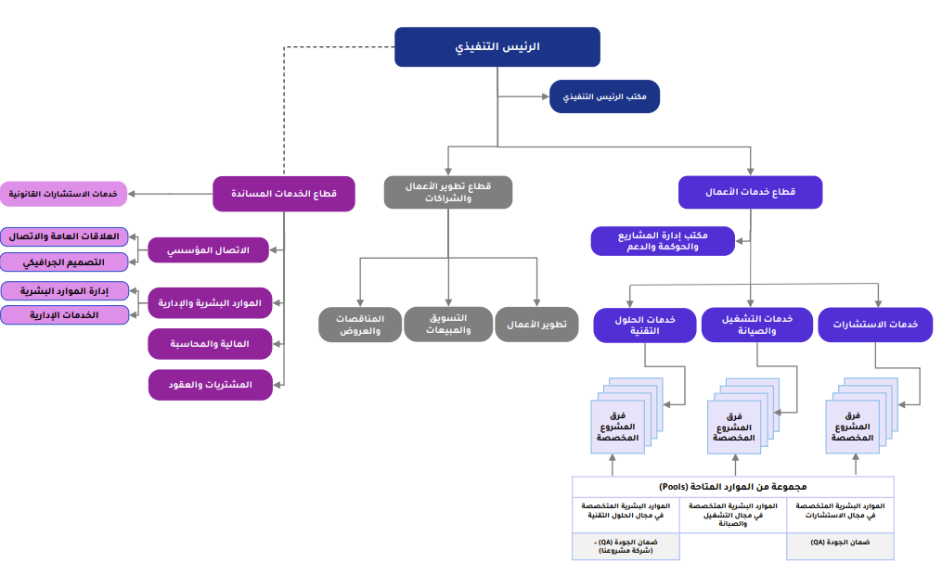
The organizational structure of the company

Slide 62
Executive Summary
Project Scope of Work
Project Implementation Methodology
The project implementation timeline
Organizational Structure and Teamwork
Project Assumptions
About the Digital Future Company
Our clients
Our Projects
62

Slide 63


































"We are honored to work with a number of entities in both the private and public sectors."

Slide 64
Executive Summary
Project Scope of Work
Project Implementation Methodology
The project implementation timeline
Organizational Structure and Teamwork
Project Assumptions
About the Digital Future Company
Clients
Our Projects
64

Slide 65
“Selected Projects for the Digital Future”
The second phase of the digital transformation project at the Ministry of Industry.
Operation and maintenance of the spatial gateway, information boards, and spatial indicators.
Providing consulting services and support for the management of digital enablers.
Preparation, design, structuring, and governance of data.
Comprehensive Application of the Technical Project Management Office
Geospatial Solutions Programs
Development of the internal and external portal for the Eastern Health Cluster.
Governance of Technology, its Structuring, and the Implementation of the Technology Strategy for the Ministry of Interior.
Providing consulting services and technical support services.
Consulting services for the development of water organization operations
Providing consulting services and technical support to develop a unified vision for the Ministry of Environment, Water, and Agriculture.
Developing standards for the inclusion of promising and leading national companies.
Development of Services for Procedures at the Ministry of Interior's Military Affairs Agency - Phase One
Development of electronic services for project management and provision of technical and strategic support to the ministry.
Details of the projects in the attachments

Slide 66


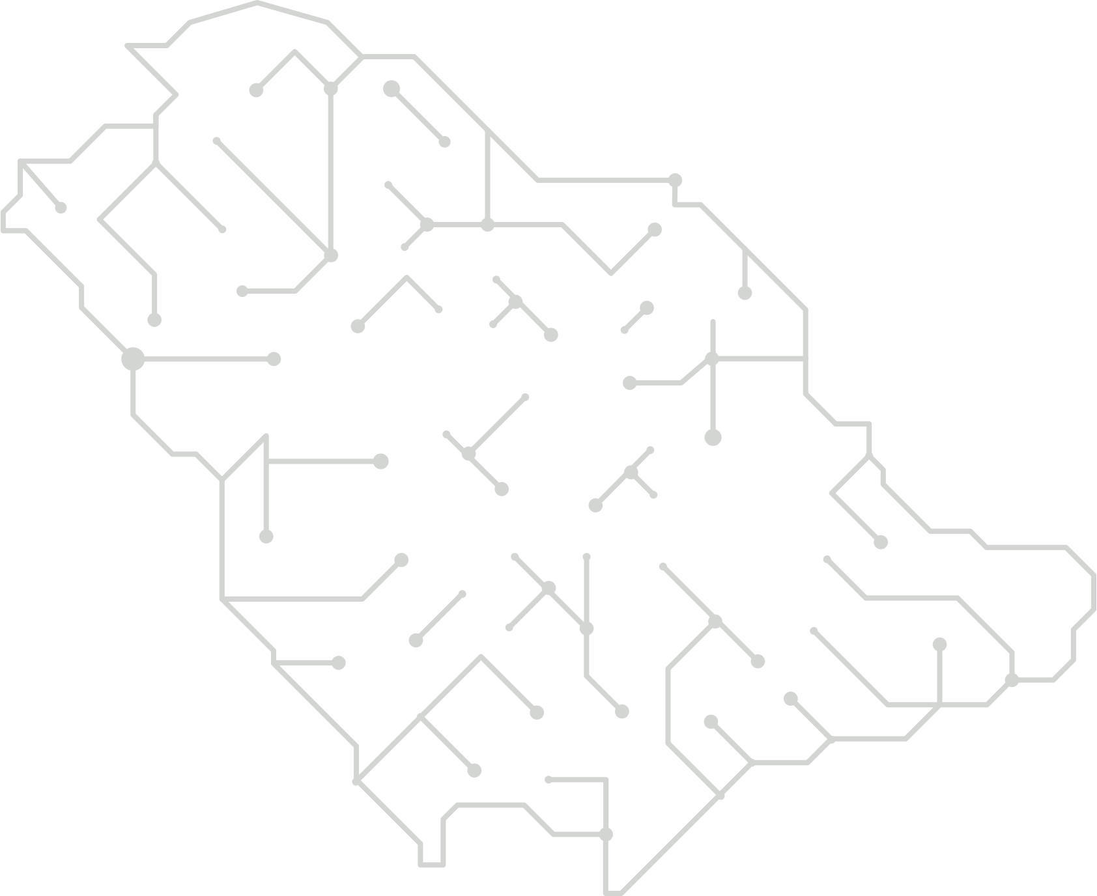
A sample of some projects that we are honored to carry out.
"15 months"
(08/2024 - 05/2023)
Project Duration
"Name"The Project
Development of the internal and external portal for the Eastern Health Cluster.
Project Overview
The Eastern Health Gathering is striving for digital transformation and keeping pace with the rapid changes in electronic government services in line with the Kingdom's Vision 2030. This will be implemented through the design and development of an internal portal for the gathering’s staff and an external portal aimed at the general public, including patients, visitors, and others.
It appears there is no Arabic text provided for translation. Please provide the text you would like me to translate, and I'll be happy to assist you!
Outputs
Scope of Implementation
Implementation and preparation of the application management system.DevOps
Policies and Procedures for Application DevelopmentSDLC Translation: Software Development Life Cycle
"Preparation of gateway environments (development, testing, production environment)"
Launch of the internal and external portal.
Periodic reports on operations and technical support.
Report on Lessons Learned and Completion of Project Delivery
Delivery of all approved project documents.
Delivery of the source code after the completion of development work.
Official Working Methodology Document for the Project and Its ApprovalIt seems there is no Arabic text provided for translation. Please share the text you would like me to translate, and I'll be happy to assist you!
The approved detailed plan for the project and the approval of the project team.
Project Charter Including the Work Plan
Report on the Project Kick-off Meeting
Document of Business Requirements
Architectural Documents and System DesignTranslation: (حلول معمارية، تصميم معماري عالٍ، تصميم معماري مفصل) Note: HLD (High-Level Design) is translated as "تصميم معماري عالٍ," and DLLD (Detailed Low-Level Design) is translated as "تصميم معماري مفصل." These terms are technical and commonly used in software and systems engineering.
Design of the Internal and External Gateway
Status Document for Application and Digital Health Management

Slide 67

Sample of some projects we are honored to undertake.
12 months
It seems you haven't provided the Arabic text that you'd like translated. Please share the text, and I'll be happy to assist you with an accurate translation.It seems that the text you provided is just the number "5." If you have more text or a specific passage you'd like translated from Arabic to English, please share that, and I'll be happy to assist!The text you provided is not in Arabic; it appears to be a combination of numbers and symbols that doesn't translate into meaningful content. If you have a specific Arabic text you'd like me to translate into English, please provide that, and I'll be happy to assist!It seems the text you would like me to translate is missing or not provided. Please provide the Arabic text you would like translated into English, and I'll be happy to assist you with that!It seems there is no Arabic text provided for translation. Please provide the text you would like me to translate, and I will be happy to assist you.
Project Duration
Project Name
Geospatial Solutions Program Project
Project Overview
"Supply of licenses and their maintenance for the solutions program."GeospatialIt seems that the Arabic text you wanted to be translated is missing. Please provide the text you'd like translated, and I'll be happy to assist you!
Scope of Implementation
Outputs
ArcGIS Enterprise Workgroup Sure, please provide the Arabic text you would like translated to English, and I'll be happy to assist you!
ArcGIS Enterprise Please provide the Arabic text you would like to have translated into English. Entitlement
ArcGIS The Arabic word "مطور" translates to "Developer" in English. If you have additional context or specific phrases related to "Developer" that you would like translated, please provide them for a more nuanced translation! Enterprise
ArcGIS It seems that there is no Arabic text provided for translation. Please provide the text you would like me to translate, and I will be happy to assist you! Analyst
ArcGIS The Arabic word "سطح المكتب" translates to "Desktop" in English. It seems that you haven't provided any Arabic text for translation. Please share the text you'd like me to translate, and I'll be happy to assist you!
ArcGIS The term "Desktop" in Arabic is "سطح المكتب." In English, it directly translates to "Desktop," which refers to the primary user interface of a computer screen where icons and files are displayed. If you need further context or additional details, please provide more information! Sure! Please provide the Arabic text you'd like translated into English.
ArcGIS The word "Spatial" in Arabic translates to "مكاني" (makānī) or "فضائي" (faḍā'ī), depending on the context. If you provide more context or specific sentences, I can offer a more accurate and nuanced translation. Analyst
ArcGIS Enterprise Please provide the Arabic text that you would like me to translate into English.

Slide 68

A sample of some of the projects we are honored to execute.
24 months
It seems that there is no Arabic text provided for translation. Could you please provide the text you would like me to translate?03/2022 – 03/2024It seems that there is no Arabic text provided for translation. Please provide the Arabic text you would like me to translate into English, and I'll be happy to assist you!
DurationThe Project
Project Name
The Comprehensive Application of the Technical Project Management Office
Project Overview
The scope of the project involves providing consulting services for the establishment and operation of both the Technical Project Management Office and the Enterprise Architecture Office.Technical Affairs "In the Ministry of Interior."
Scope of Implementation
Outcomes
Support and operation of the Institutional Infrastructure Office
Training and Knowledge Transfer.
Support and operation of the Project Management Office.
Development of Methodology and Processes for the Project Management OfficeProject Management Office -
Development and Support of the Institutional Infrastructure OfficeEnterprise Architecture Office -
Design, installation, development, and testing of a project management system.

Slide 69
A sample of some projects that we had the honor of executing.
Duration of the project
It seems that the text you want me to translate is simply the number "18." If you meant to provide a longer text for translation, please share it, and I'll be happy to assist!The translation of the Arabic word "شهر" is "month."
It seems you provided an incomplete text. Please share the full Arabic text that you would like me to translate to English, and I will be happy to assist you.09/2024It seems that you did not include the Arabic text you would like me to translate. Please provide the text, and I will be glad to assist you with the translation.
Project Name
Preparation, design, structuring, and governance of data.
Project Overview
The scope of the project involves providing consulting services for the preparation, design, structuring, and governance of the target data architecture aimed at enabling the roadmap for digital transformation.
Outputs
Scope of Implementation
Evaluation Phase Report.
Defining interim reports
Report on the Infrastructure Phase
Target Structure Phase Report
"Report on the Phase of the Digital Transformation Roadmap"
Operating Phase
Enterprise Architecture Bundle 5 Users

Slide 70

A sample of some projects that we are honored to implement.
12 months
Sure, please provide the Arabic text you would like me to translate into English.September 2022 – September 2023It seems you've provided an opening parenthesis without the actual Arabic text to translate. Please provide the Arabic text you'd like me to translate into English, and I'll be happy to assist you!
Project Duration
Project Name
Providing consulting services and support for the management of digital enablers.
Project Overview
The scope of work involves the establishment and development of digital enablement management within the General Authority for Desalination of Seawater.
Outputs
Scope of Execution
Preparation of the Job Description Document for the Management of Digital Enablements
Preparation of a document for the distribution of roles and responsibilities among the organizational units.
Preparation of a Document for Measuring the Quality of Digital Services
Preparation of a Document to Enhance the Interactive Relationship with Stakeholders
Preparation of a training needs analysis document for the management of digital enablers.
Preparation of the training plan document for the development of employees in the Digital Enablement Department during the digital transformation.
Preparation of a Document for the Development Plan of Digital Enablement Leadership
Preparation of the Current and Future Situation Document
Preparation of a Strategic Document for the Digital Transformation of Digital Enablement Management
Preparation of a Digital Enablement Roadmap Document
Preparation of the Implementation Plan Document for Digital Enablement Management
Preparation of the Operational Framework Document for Digital Enablement Management
"Preparing a Governance Document for Digital Enablement Management"
Preparation of a Document to Support Institutional Change Management

Slide 71
A sample of some projects that we are honored to implement.
Translation: 24 months
It seems there may have been a mistake, as there is no Arabic text provided for translation. Please provide the Arabic text you would like me to translate, and I will assist you accordingly.It seems that there is no Arabic text provided for translation. Please provide the Arabic text you would like me to translate into English, and I'll be happy to assist you!It seems that there’s no Arabic text provided for translation. Please share the text you would like me to translate, and I’ll be happy to assist you!2025It seems that you only provided "07/" without any accompanying Arabic text to translate. Please share the Arabic text you would like me to translate, and I would be happy to assist you!The text you've provided is simply "2023," which appears to be a year. There is no additional Arabic text to translate. If you have more text or specific phrases you'd like to have translated, please share them, and I'd be happy to assist!It seems that you have not provided any Arabic text to translate. Please provide the text you would like me to translate, and I'll be happy to assist!
Duration of the Project
Project Name
Operation and maintenance of the spatial portal, information boards, and spatial indicators.
Project Overview
The Nuclear and Radiological Regulatory Authority seeks technical and consultancy support, as well as operation and maintenance services for all components of information systems.
Geography, in addition to the spatial framework, information boards, and indicators, aims to achieve objectives and ensure the continuous functioning of the system with all its components, free from obstacles or issues that may disrupt daily operations. This is accomplished through providing appropriate technical and consulting support, as well as enhancements and modifications to the current system, which meet the goals and aspirations of the authority and align with its new requirements. This will assist in implementing upgrades to the operational components of the systems to enhance performance and reliability.
Scope of Implementation
Outputs
Licenses for Geographic Information System (GIS) server software.
A license for a tool for spatial statistical analysis for desktop GIS software.
"License for a spatial analysis tool for desktop software of geographic information systems."
Geographic Database Administrator
Geographic Information Systems Analyst
Geographic Information Systems (GIS) Application Developer
GIS Application Developer
Office licenses for Geographic Information Systems softwareArcGIS Desktop Sure, please provide the Arabic text that you would like to have translated into English. The translation of the Arabic term "license" would depend on the specific context in which it is used, as it can refer to different types of permission or authorization. However, the general term in English for "license" is simply "license" as well. If you provide additional context or a full sentence, I can give a more precise translation. ArcGIS It seems that you haven't provided the Arabic text you'd like me to translate. Please share the text, and I'll be happy to assist you with an accurate translation.

Slide 72


A sample of some projects that we are honored to have executed.
The Arabic text you provided consists only of the number "12," which translates directly to "12" in English. If you have additional text to translate, please provide it, and I'd be happy to assist!Month
Of course! Please provide the Arabic text you would like me to translate.08/2021 – 08/2022It seems that you haven't provided the Arabic text that you would like me to translate. Please share the text you'd like translated, and I will be happy to assist you!
Project Duration
Project Name
Phase Two Project of the Digital Transformation Initiative
Project Overview
The project's scope of work consists of building a digital infrastructure to enhance and achieve the goals of Vision 2030 by seizing the available opportunities in the digital age, achieving economic sustainability, attaining global leadership, and improving the quality of life.
Outputs
Scope of Execution
Identifying the digital gap.
Defining the digital transformation plan.
Identifying and monitoring the key success factors for digital transformation.
Identifying and monitoring the key success factors for digital transformation.
Identifying and monitoring digital performance indicators.
Regular monitoring of the digital transformation plan.
Analysis of the current situation.
Determining needs.
Feasibility Study of Digital Platforms Application and Analysis of the Latest Modern Technologies.
Updating and developing the digital transformation strategy.
Defining digital governance.
"Establishing and defining the operational plan for the Digital Transformation Office."

Slide 73

A sample of some projects we were honored to execute.
12 months
October 2020 – October 2021
Project Duration
Project Name
Development of electronic services for project management and providing technical and strategic support to the ministry.
Project Overview
The Digital Future Company has contributed to the implementation of a project aimed at providing consulting services to develop a unified vision for the Ministry of Environment, Water, and Agriculture that aligns with Saudi Arabia's Vision 2030. This initiative seeks to enhance performance levels, improve capacities, and manage projects. It includes strengthening the project management team to empower the administration in achieving its objectives within the framework of the Ministry of Environment, Water, and Agriculture's plan, encompassing the adoption and application of the best global practices (methodologies, project management systems, and techniques).
The Outputs
Scope of Implementation
Management of Program and Project Portfolios
Model of Office, Organizational Structure, and Governance Framework
Policy and Procedure Manual
Project Management System
Translation: Organizational structure, policies, and procedures
Development of Electronic Services
Current Situation Assessment Report
Analysis of Technical Tools
Design and development of the operational model for technical programs.
The study of the upgrade program is being submitted to the strategic committee.
Report on the National Agriculture Strategy and Executive Summary
Comprehensive Development Plan
The Operational Model for the Project Office

Slide 74
A sample of some of the projects we had the honor of executing.
12 months
It seems there may have been a misunderstanding; I do not see any Arabic text provided for translation. Please provide the text you would like translated, and I will be happy to assist!February 2024 – February 2025It seems there may have been a misunderstanding as there is no Arabic text provided in your message. Please provide the Arabic text you would like me to translate into English, and I will be happy to assist you!
DurationThe Project
Project Name
"Developing Services for the Workflow Procedures at the Ministry of Interior's Military Affairs Agency - Phase One"
Project Overview
The Ministry of Interior Agency for Military Affairs seeks to implement the project for developing workflow service procedures within the Agency for Military Affairs, phase one, to employ and utilize it in the Ministry of Interior Agency for Military Affairs, and to assist decision-makers inThe Ministry of Interior's Agency for Military Affairs is dedicated to providing the best services, enhancing productivity, and minimizing costs, while also monitoring the status of the institution's projects."And following it."
Scope of Execution
Outcomes
Development Works Development Solutions "Business" The translation of "وتحسين" is "and improvement." If it appears in a specific context, additional nuances or meanings might be considered based on how it relates to other parts of the text.Work Procedures
Development Works DevelopmentWeb services and linking them to the business platform.The translation of the Arabic term "الرقمية" is "digital." If you need additional context or a specific usage of the term in a sentence, please provide more details. The translation of "ابشر" is "Gladly" or "You can count on me." It is an expression often used to convey readiness to help or promise good news, depending on the context. "Interior" (Note: The word "داخلية" can mean "interior" or "internal," depending on the context. If it refers to a specific field such as politics or departments, it could mean "ministry of interior" or "domestic affairs." Therefore, if there's more context, it might yield a different translation.)

Slide 75
A sample of some projects that we have had the honor of implementing.
6 months
(02/2023 - 08/2023) Translation: (02/2023 - 08/2023)
Project Duration
Project Name
Project to Develop Standards for Incorporating Promising and Leading National Companies
Project Overview
Developing a list of 800 "leading" and "promising" Saudi companies or more (including information for each of the specified criteria) that could be deemed suitable for receiving government support in the future, as this support is likely to lead to growth and international expansion, including outward direct investment (ODI). This involves refining and enhancing the current criteria used to classify national companies as "leading" and "promising" in terms of future expansion and international growth. The application of these criteria to current Saudi companies aims to identify 700 "leading" national companies and 100 "promising" ones.
Scope of Implementation
Outcomes
Document for Analyzing the Current Situation
Operational Model Document
A final list of 800 national companies (700 leading and 100 promising).

Slide 76
A sample of some projects that we are honored to execute.
It seems that you've provided the number "24" without any additional context or accompanying text for translation. If you have a specific Arabic text you would like me to translate into English, please provide that text, and I will be happy to assist you!"Month"
Of course! Please provide the Arabic text that you would like me to translate into English.November 2020 – November 2022It seems that there is no Arabic text provided for translation. Please share the text you would like translated, and I'll be happy to assist you!
Project Duration
Project Name
Providing consultancy services and technical support to develop a unified vision for the Ministry of Environment, Water, and Agriculture.
Project Overview
The project is based on providing advisory and technical support to the ministry in order to achieve its objectives and implement the outcomes of the project aimed at offering consulting services and technical support to develop a unified vision for the Ministry of Environment, Water, and Agriculture. This will be accomplished through the following specified tasks and services for the Ministry of Environment, Water, and Agriculture, and the scope of the project encompasses the following areas:
Axis One: Consulting services for studying, researching, and investigating agricultural land data in the Al-Jawf region.
Axis Two: A Study of the Current Status of Vegetation Cover in the Kingdom of Saudi Arabia and Providing Solutions for Its Preservation and Development.
Axis Three: Strategic support for the studies required by the ministry during the project's duration.
Scope of Implementation
Outcomes
Consulting Services
Study of the Current Situation of Vegetation Cover in the Kingdom of Saudi Arabia
"Strategy for Allocating Assets for Existing Desalinated Seawater Production"
Study on Evaluating the Quantities of Agricultural Waste
Executive Regulations for the Environmental Sector
Risk Management Plan

Slide 77

A sample of some of the projects we are honored to have executed.
40 months
It seems that there is no Arabic text provided for translation. Please provide the text you would like me to translate, and I will be happy to assist you!08/2021 – 12/2024It seems there was an error as no Arabic text was provided for translation. Please provide the Arabic text you would like me to translate into English, and I will be happy to assist you!
Project Duration
Project Name
Provision of consulting services for developmentWorksWater Regulator
Project Overview
The scope of the project involves executing a consultancy services project for the development of the water regulator's operations, by providing advisory and technical support to the water regulator in order to achieve its objectives.
Outputs
Scope of Execution
Designing a dashboard and reports to monitor performance
Organizational Development for Water Services Organization:
Service Level Agreement Document
Guide to Main Operations and Procedures
Job Description Guide
Risk Management Plan
Identifying the needs and requirements necessary for developing the water organization’s operations.
Executive Planning and Performance Measurement for Organizational Activities:
Document for Diagnosing the Current Situation and Benchmarking
Operational Model Document
Guide to Initiatives and Projects
Roadmap Document
Operational Plan Document
Guide to Workplace Development Standards
Definition and establishment of performance indicators for the organizer's departments.
"Proposal of several technical solutions along with a comparison among them and recommendations."

Slide 78
A sample of some of the projects we have had the honor to execute.
12 months
Sure! Please provide the Arabic text you'd like me to translate, and I'll be happy to assist you.July 2021 – July 2022
Project Duration
Project Name
Providing consulting services and offering technical support services.
Project Overview
The scope of the project involves providing consulting services and offering technical support for the "Operation and Implementation of Urban Development and Enhancing Cooperation with Relevant Entities (Phase Two)" project.
Outputs
Scope of Implementation
Providing project management services throughout the duration of the project.
Providing various specialized operational consulting services throughout the duration of the project.
Designing and developing project reports, ensuring that standardized and approved templates are utilized.
Design and printing of outputs for the project on operating and applying urban development and enhancing cooperation with relevant agencies (Phase Two).
Printing atlases of urban development priorities and execution schedules for each city and preparing the necessary outputs to be presented to regional councils (Task Two).

Slide 79


A sample of some projects that we are honored to have undertaken.
It seems like there might have been a misunderstanding, as the number "36" does not provide any text to translate. Please provide the Arabic text you would like translated, and I'll be happy to assist!Month
Of course, please provide the Arabic text you would like me to translate into English.The text you provided appears to be a date range rather than a passage with content to translate. It reads as "08/2019 – 08/2022," which indicates the duration from August 2019 to August 2022. If you have additional text or specific content that you'd like to translate, please provide that, and I would be happy to assist you!
Project Duration
Project Name
Project for the Governance of Technology, its Structuring, and the Implementation of the Technology Strategy for the Ministry of Interior.
Project Overview
The scope of the project involves providing consulting services for the governance and structuring of technology, as well as implementing the technology strategy for the Ministry of Interior.It seems that there is no Arabic text provided for translation. Please provide the text you would like translated, and I'll be happy to assist you.
Outputs
Scope of Implementation
Preparation of a Training Needs Assessment Plan
Preparation of a Document on the Top 10 Technological Challenges
"Establishing rules and systems for information technology to simplify technology governance."
Preparation of the technical structure document for technical alignment.
Development of a Strategic Management System for Technology and Measurement of Performance Indicators
Development of the Administrative Business System
Analysis and study of technological projects and initiatives (sources of project funding)
Definition of Information Security Standards for Mobile Telecommunications
Definition of Information Security Standards for Vehicles
Preparation of the document for online training courses in the field of management and human resources.
Preparation of the Document for Electronic Training Courses in the Field of Technology
Developing the Technical Strategy
Preparation of the Technical Policy Document
Preparation of the Digital Transformation Plan
Preparation of the Strategic Map for the General Department of Information Technology
Preparation of a Roadmap for Digital Transformation in IT Management

Slide 80
Thank you.

